Slide 1
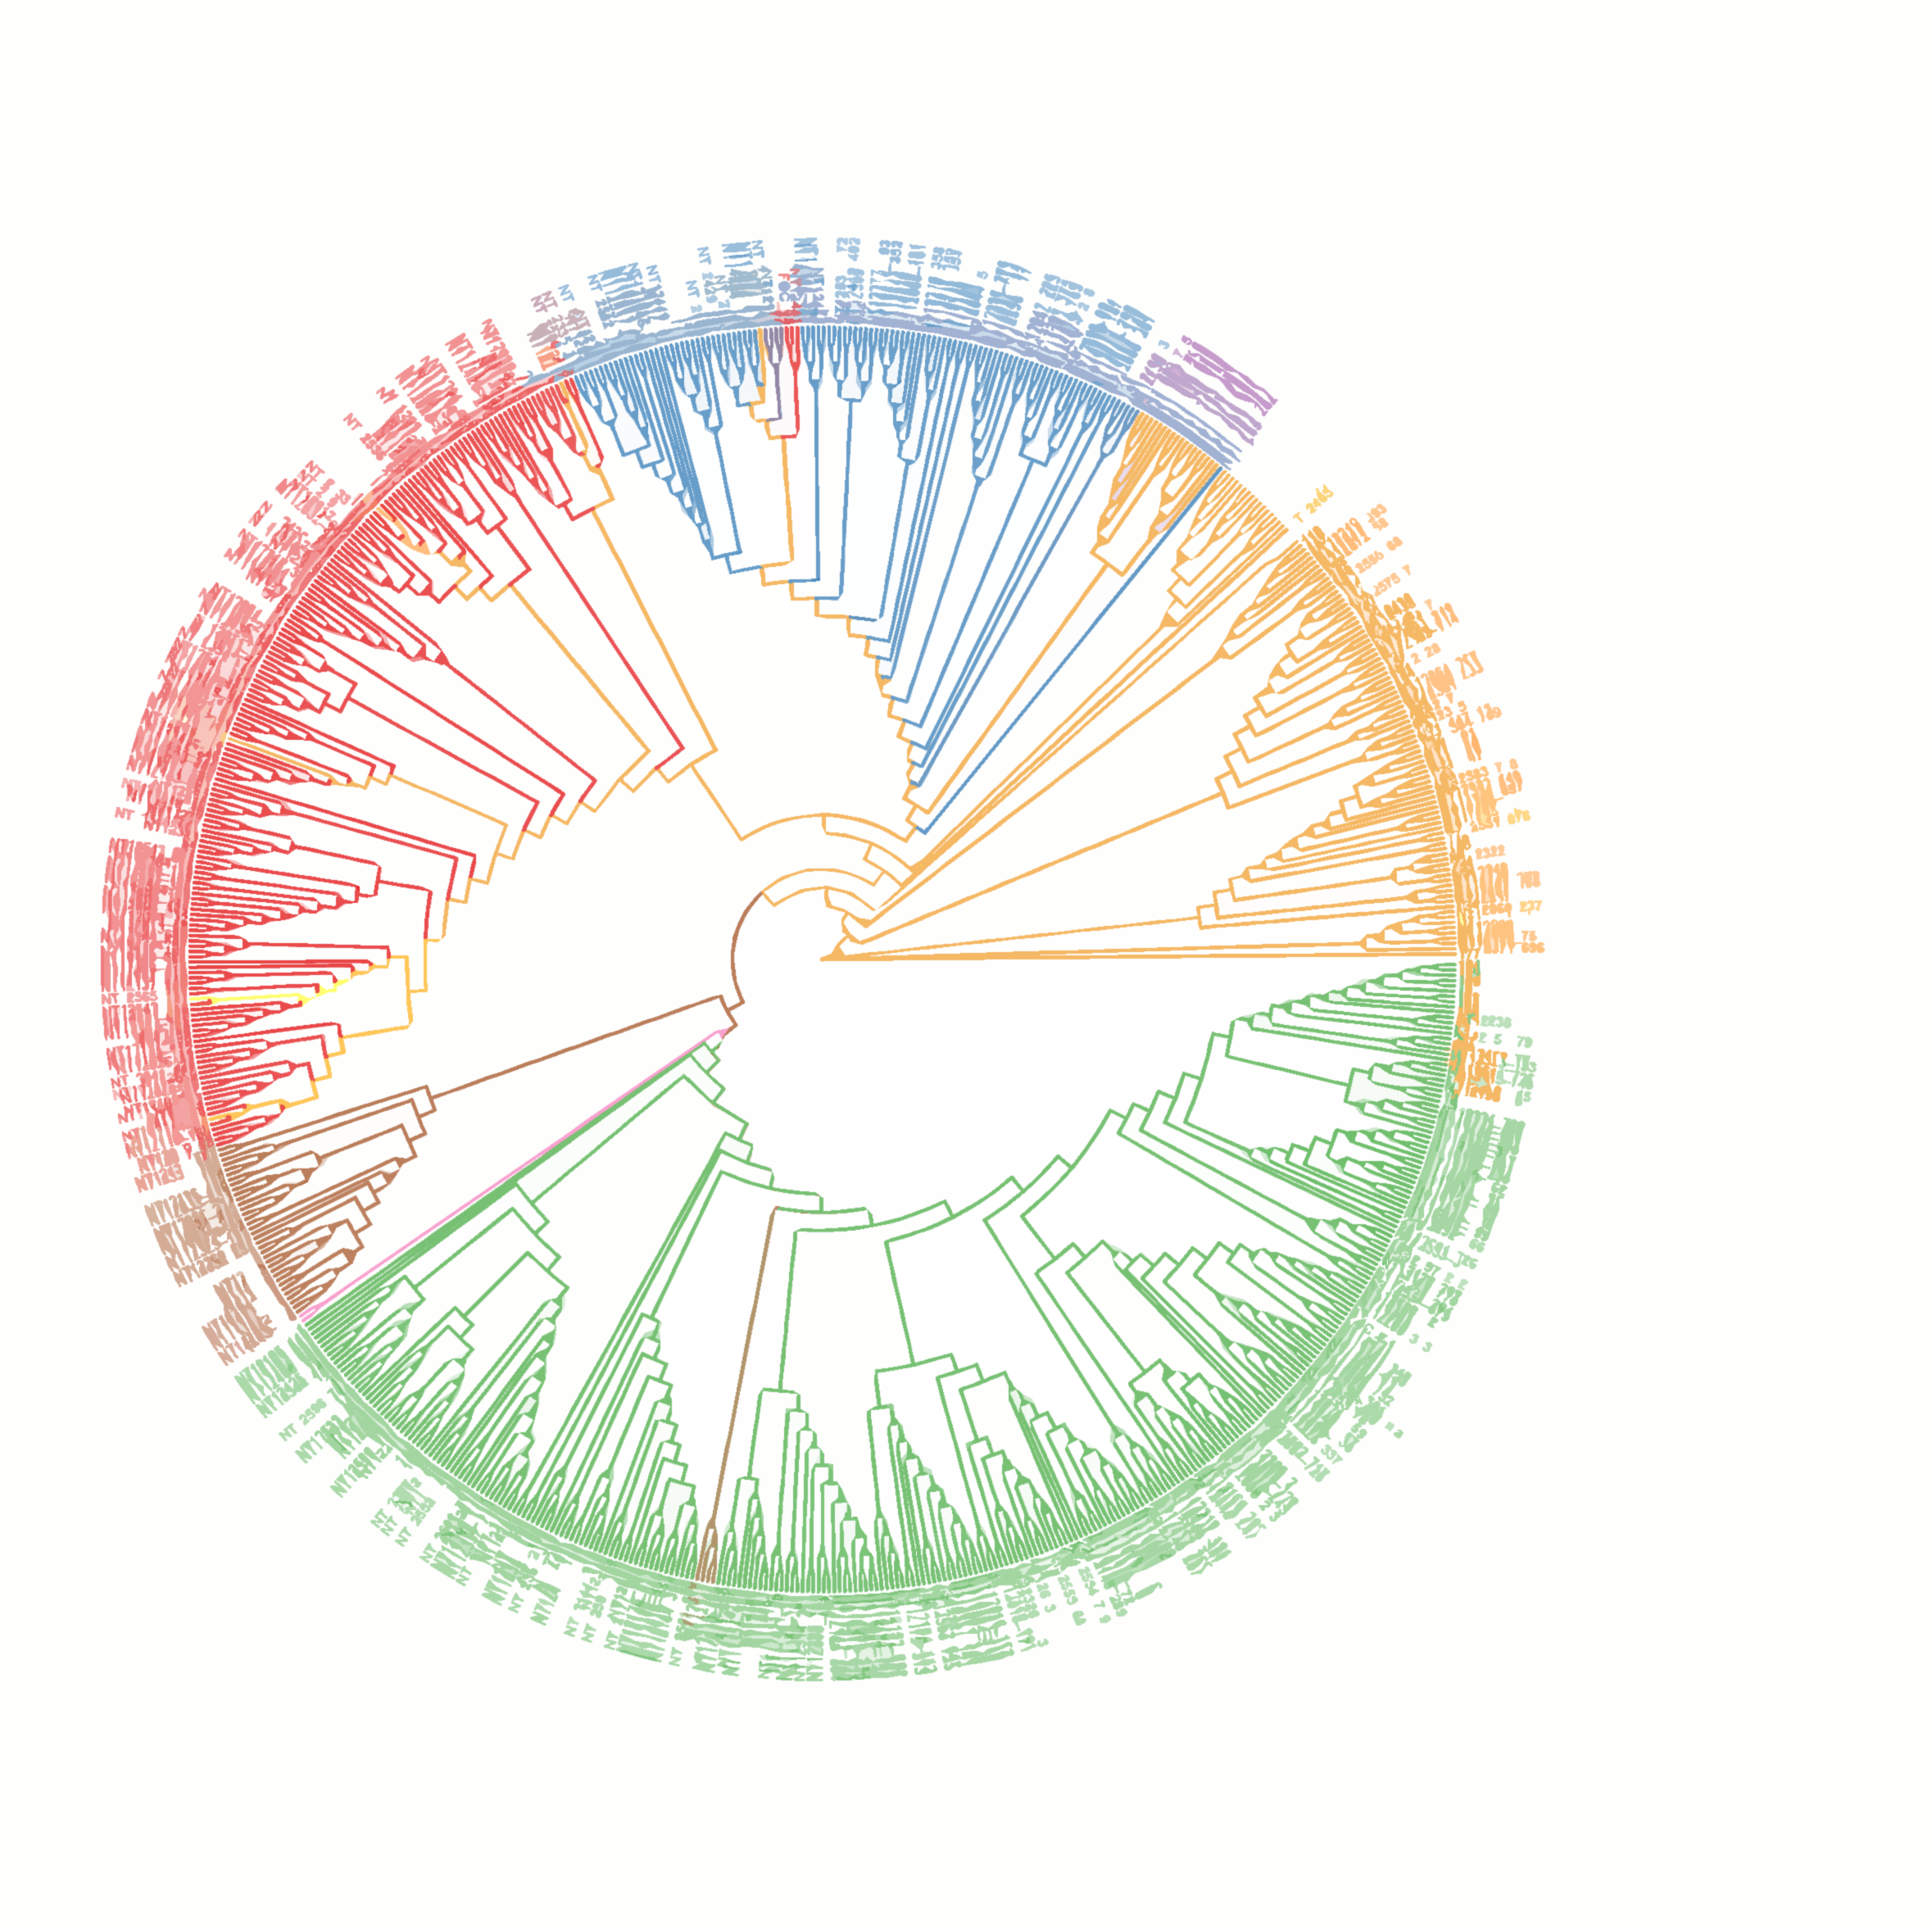


Exploring the potential of the E. coli pangenome
Daniel Martínez Martínez
Host-Microbe Co-Metabolism lab
Lab meeting (27/04/2022)

Slide 2
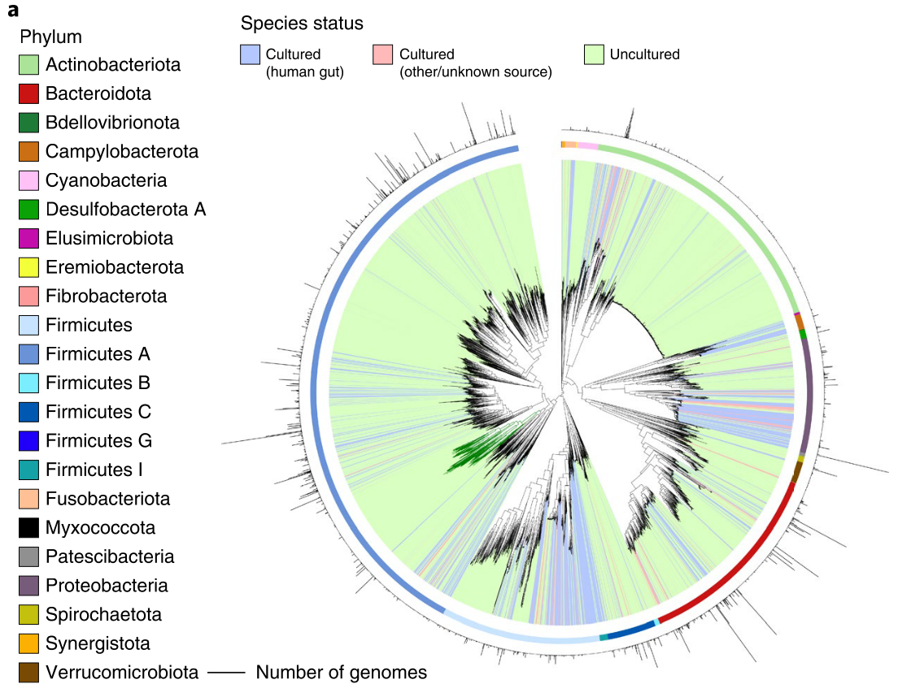
Introduction – increasing the resolution in the microbiome
~ 4500 microbial species
~ 200K non-redundant genomes
Almeida et al., 2020
Notes:
Microbiome studies are increasingly more accurate at capturing the ecological complexity of the microbial populations. In a recent paper by Alex Almeida, they were able to generate a

Slide 3
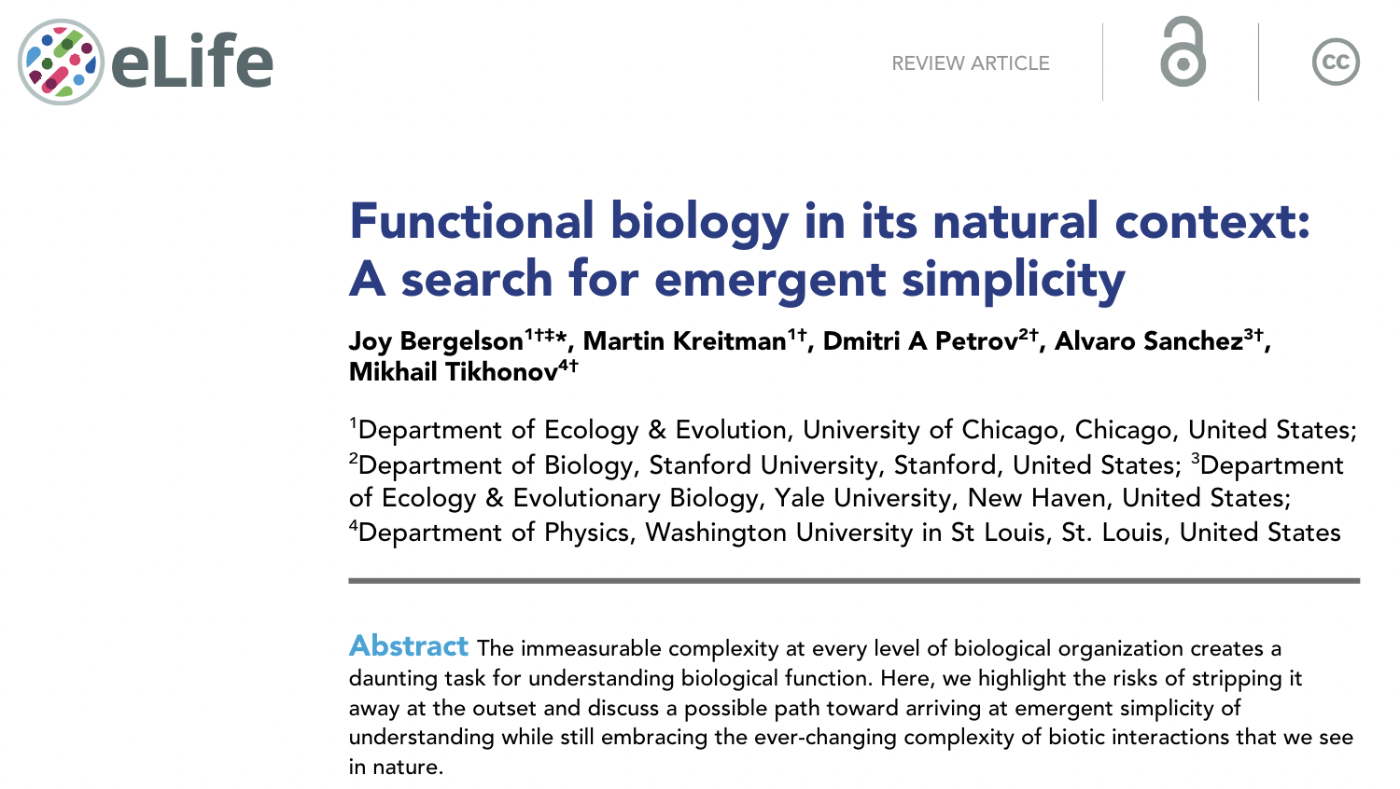
Introduction – bringing the natural context to the lab

Slide 4
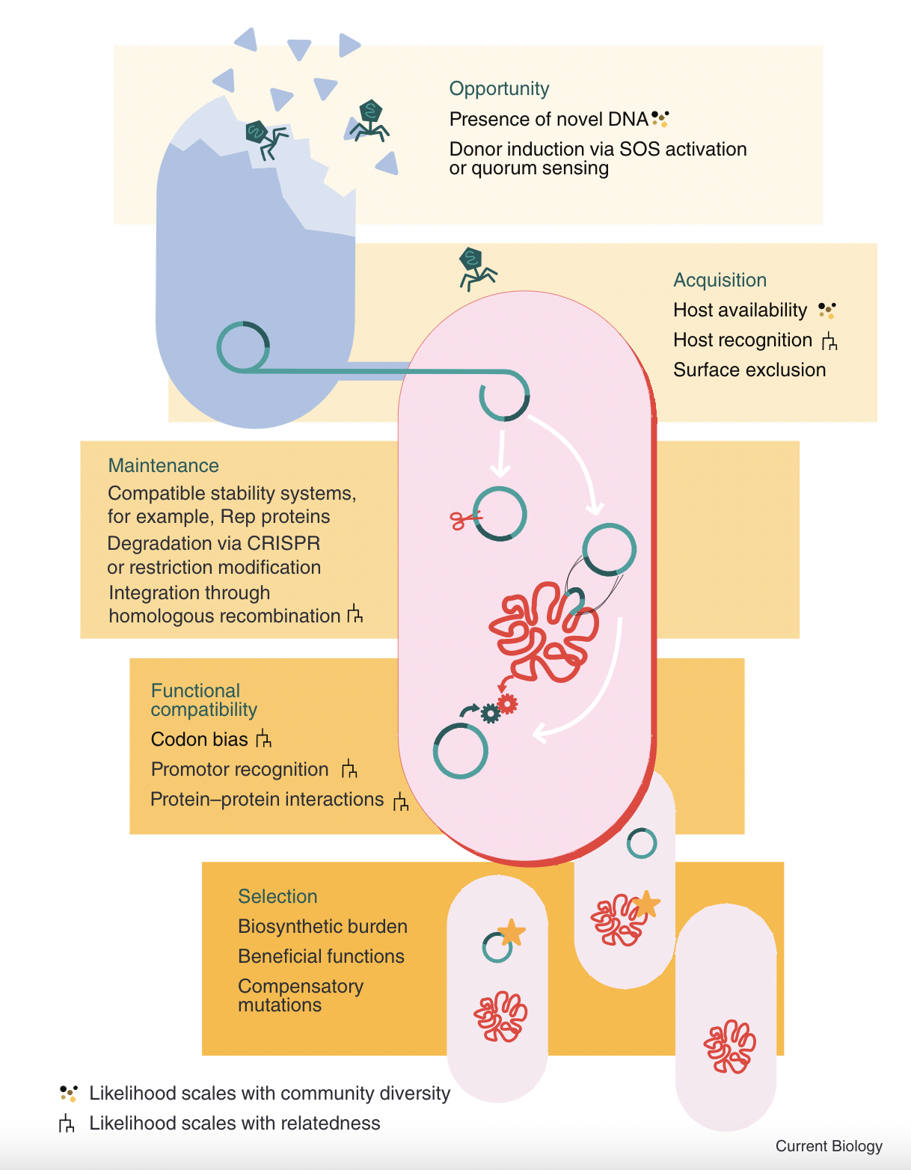
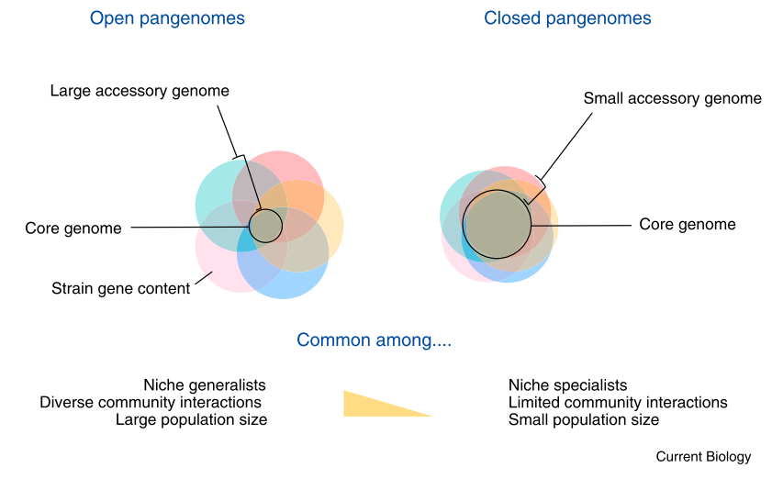
Introduction –the vastness of a single species
Brockhurst et al., 2019
Notes:
The concept of pangenome is quite recent, and is defined as the set of all the genes present in a given species and can be subdivided into the accessory genome, present in only some of the genomes, and the core genome, present in all the genomes. Pangenomes are dynamic systems that are in constant evolution
What is interesting is that genes within a pangenome are either common or rare in the population
As an example that falls very close to the topic of this talk, Marie Touchon and colleagues explored the pangenome of more than 1000 genomes from E. coli and how it evolved recently.

Slide 5
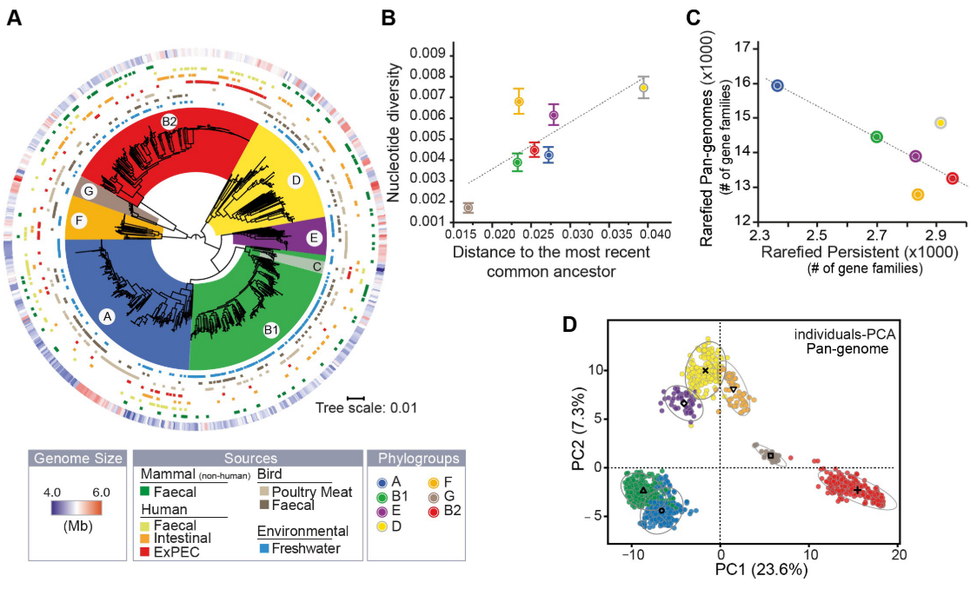
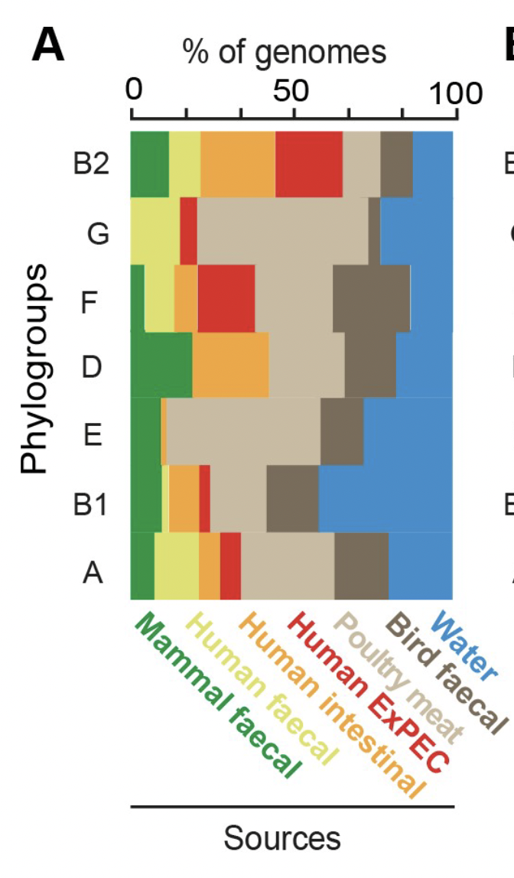
Introduction –the vastness of a single species
Touchon et al., 2020

Slide 6
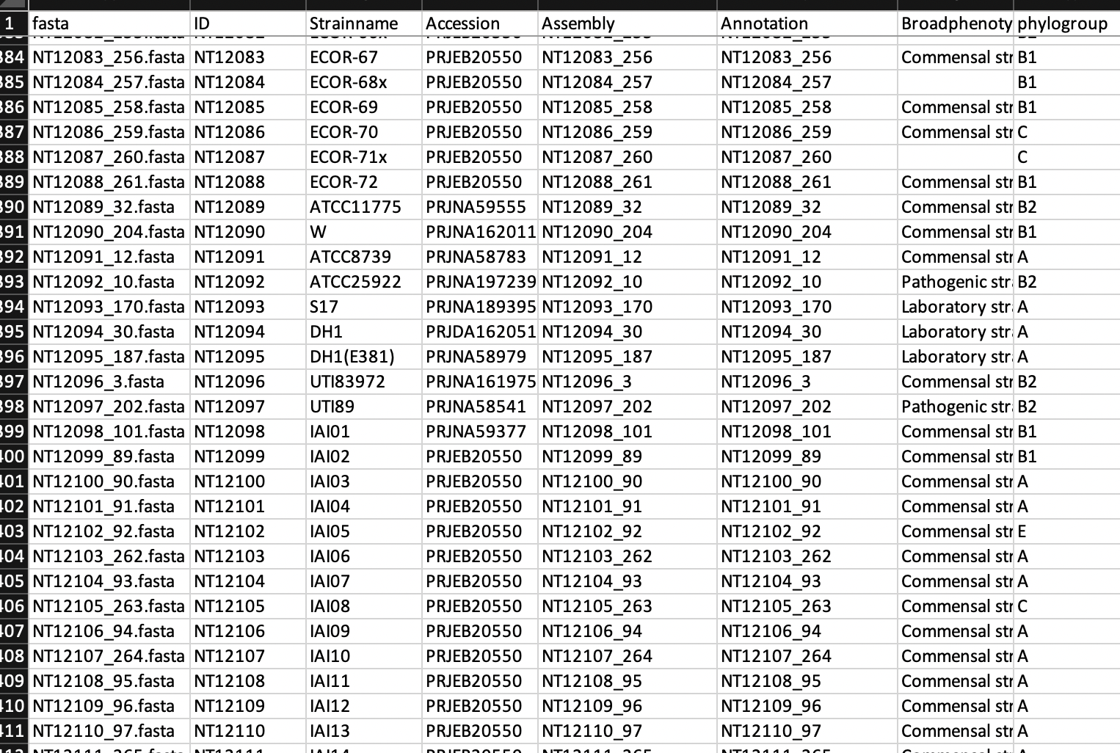
Our resources
E. coli strains
151 pathogenic strains
16 laboratory strains
337 animal and human commensals
234 human gut commensals
6 uncharacterized strains
746 strains
+ ~50 strains (experimental evolution,
and other sources)
~800 strains
We have access to all
strains for experiments
Notes:
We wanted to study their natural products by studying the biosynthetic gene clusters, which are
It’s very important to know that we have access to all these strains, and we can make experiments with them, what gives us the power to navigate the genetic space within the pangenome in the context of the host.

Slide 7
Unravelling the complexity – sources of variation
PG collection
Worm phenotype
Metabolic capacity
Phylogroups
Bacterial phenotype
Genomic info
Annotation
Pangenome Calculation
gene P/A
gene variants
Structural variants
BGCs (biosynthetic gene clusters)
Prophages
Cryptic prophages
Plasmids
GFCs (Gene family clusters)
Metformin resistance
Spheroids (Kristin), worm transcription profile (Andreea)
Directed/experimental evolution
Sources of variation

Slide 8
Worm and Strain phenotype with metformin

Slide 9
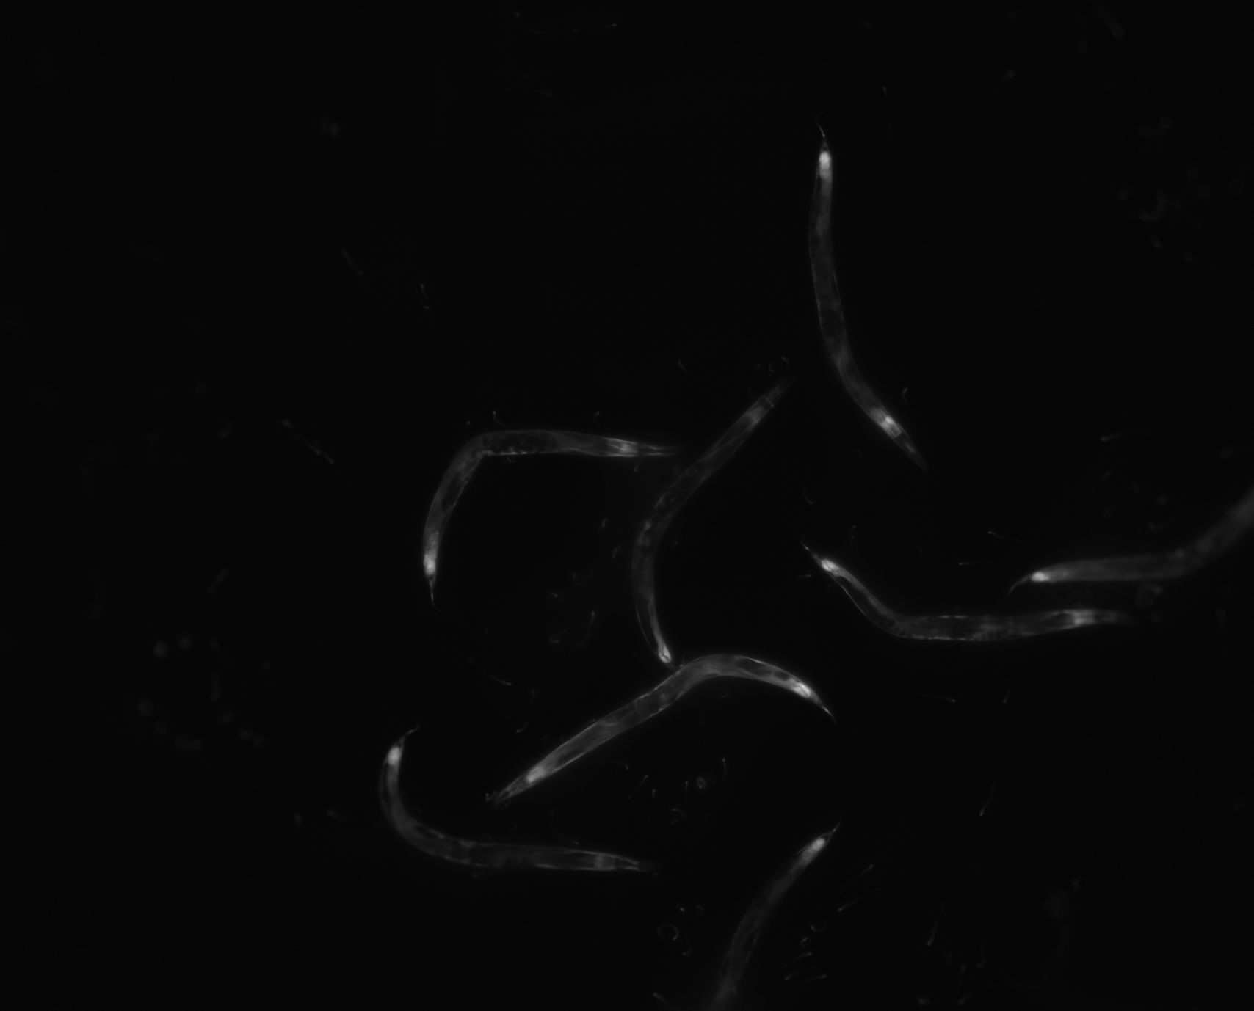
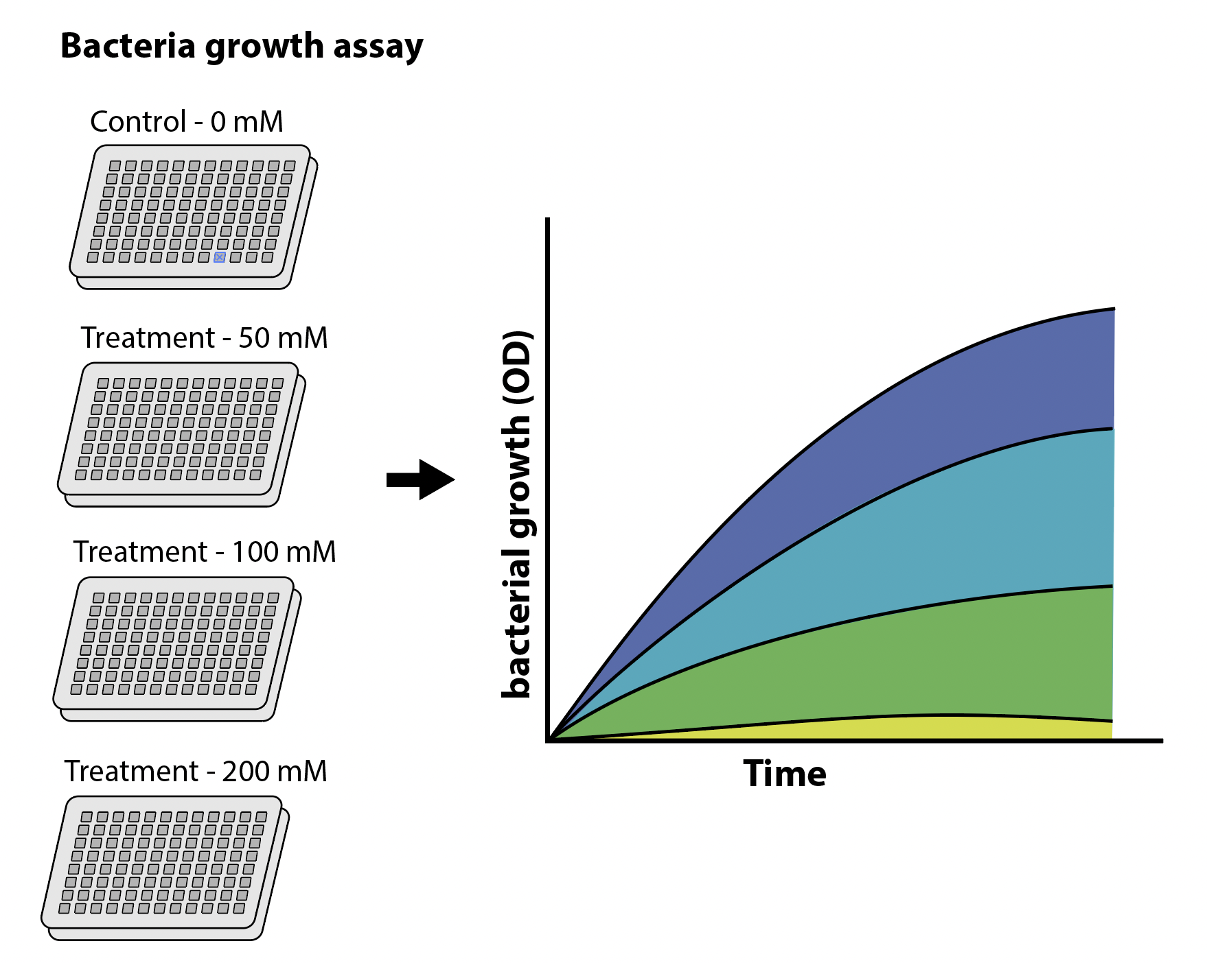

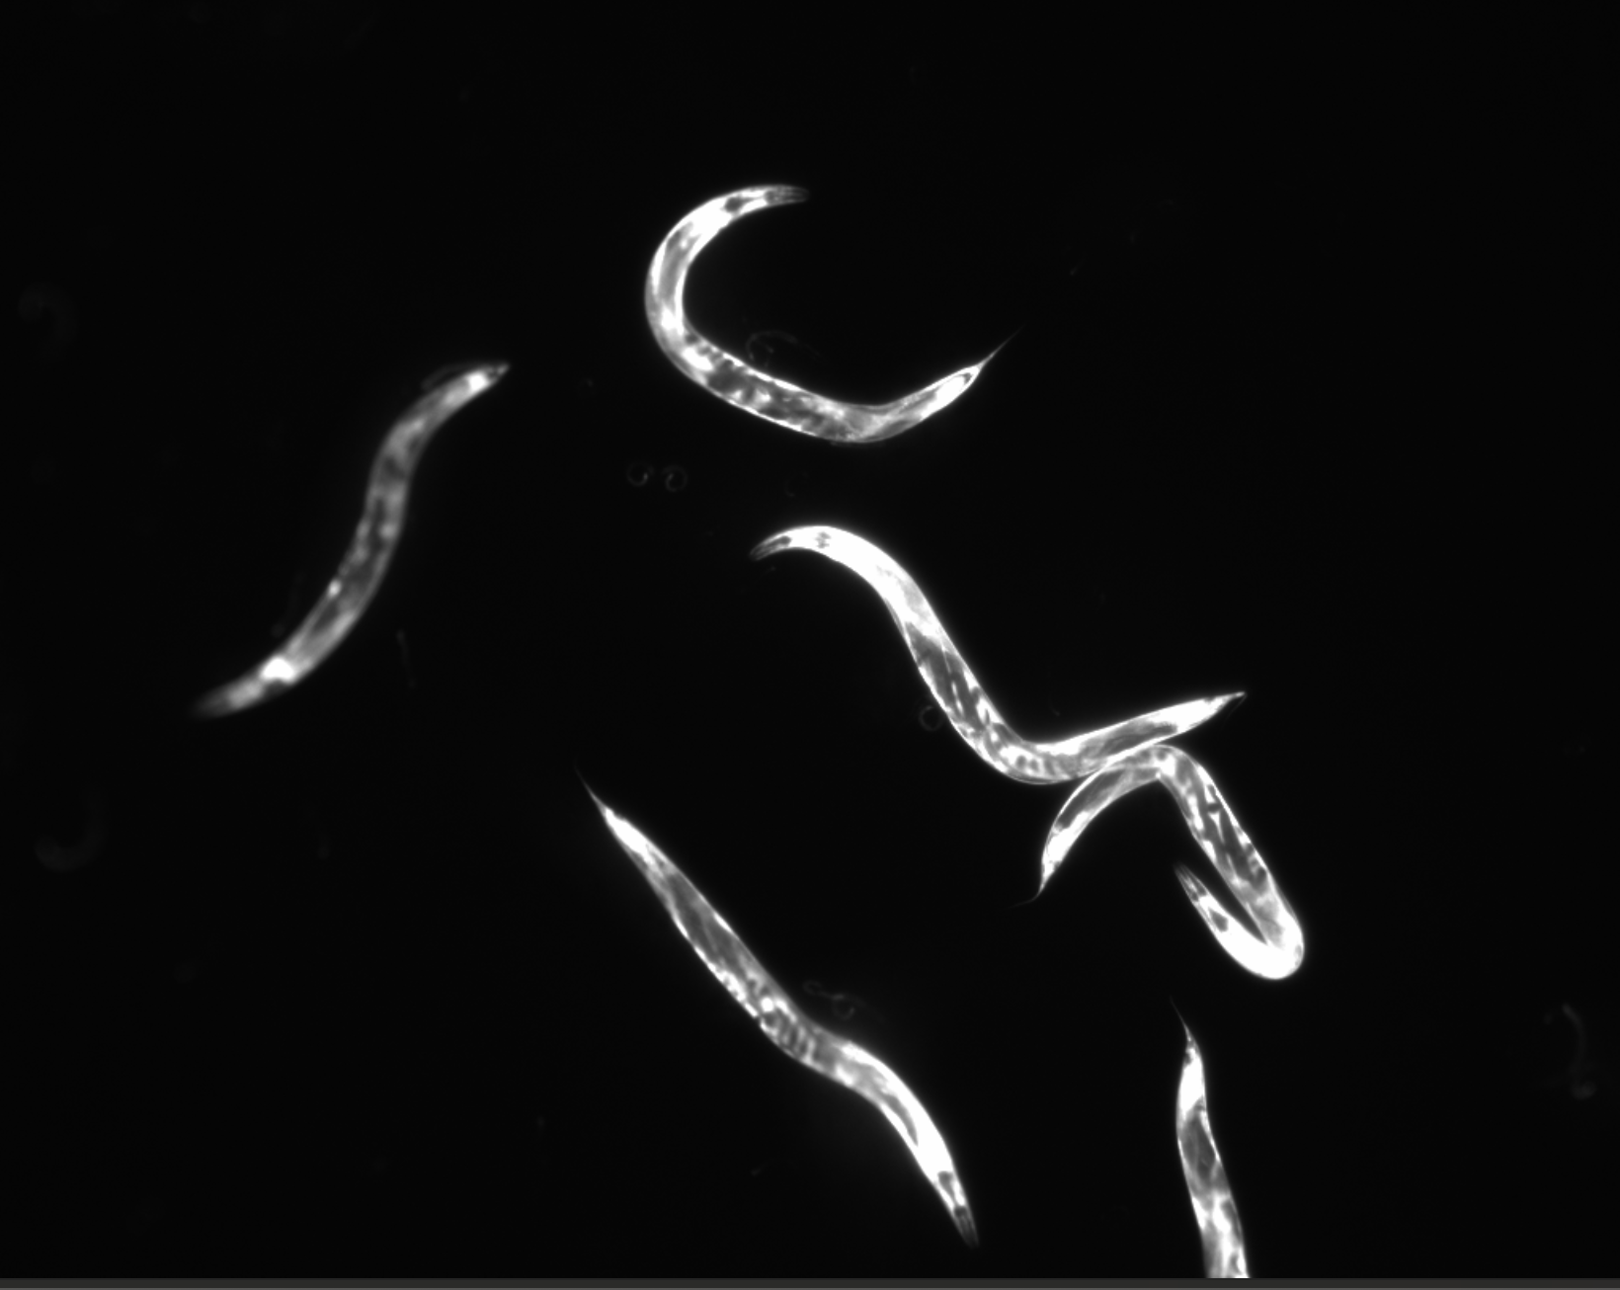
Using the worm as a readout for host-bacterial interactions
0 mM Metformin
Pacs-2::GFP as our reporter
Metformin as a treatment
50 mM Metformin

Slide 10
Using the worm as a readout for host-bacterial interactions

Slide 11
Using the worm as a readout for host-bacterial interactions
A strong strain-specific behaviour!

Slide 12
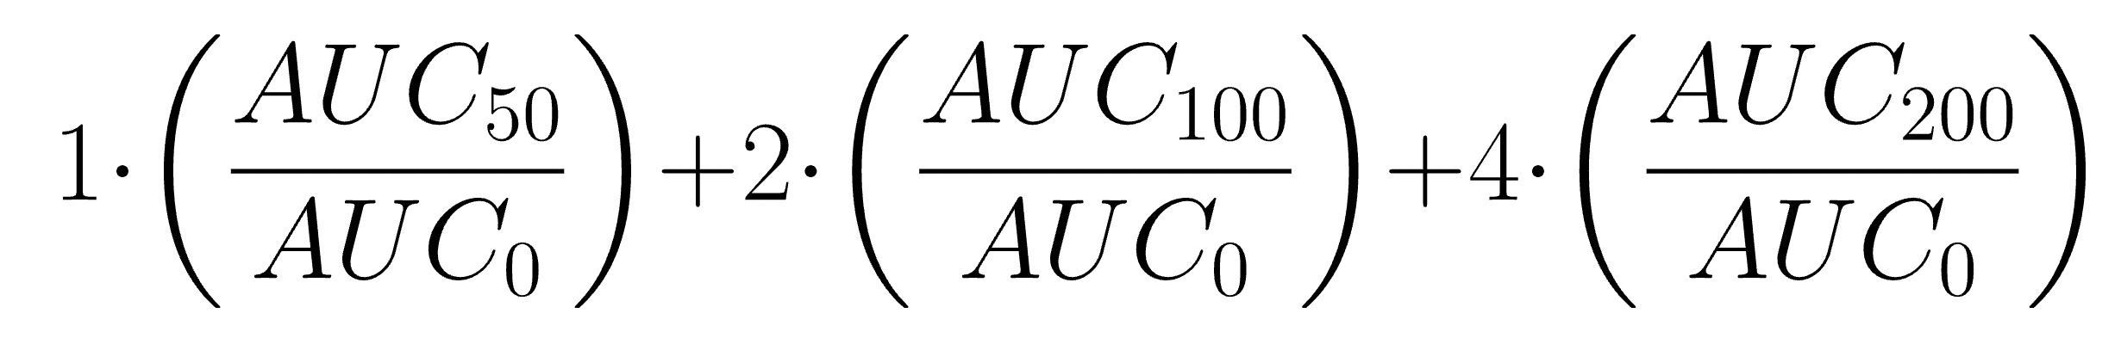
Bacterial growth phenotype
0 mM
50 mM
100 mM
200 mM
Resistance score

Slide 13
Bacterial growth phenotype – overview

Slide 14
Pangenome and phylogeny

Slide 15
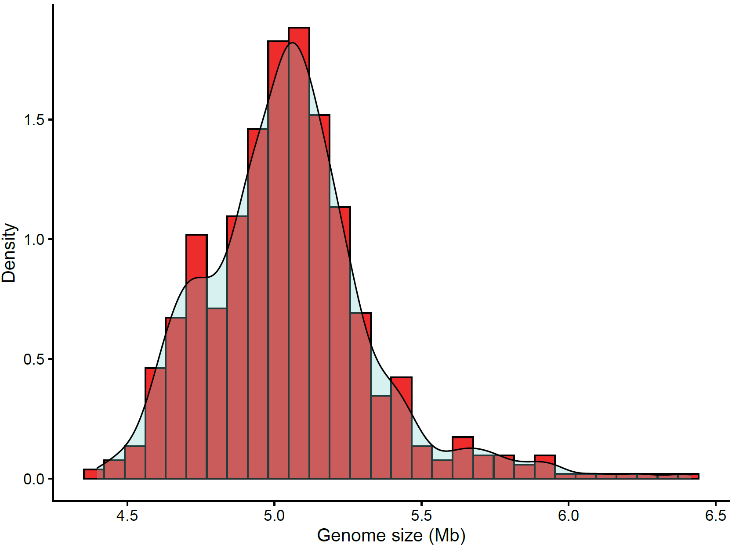
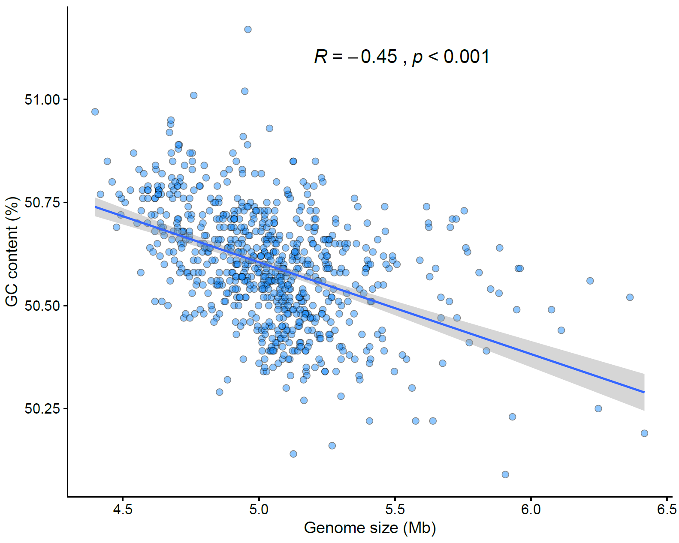
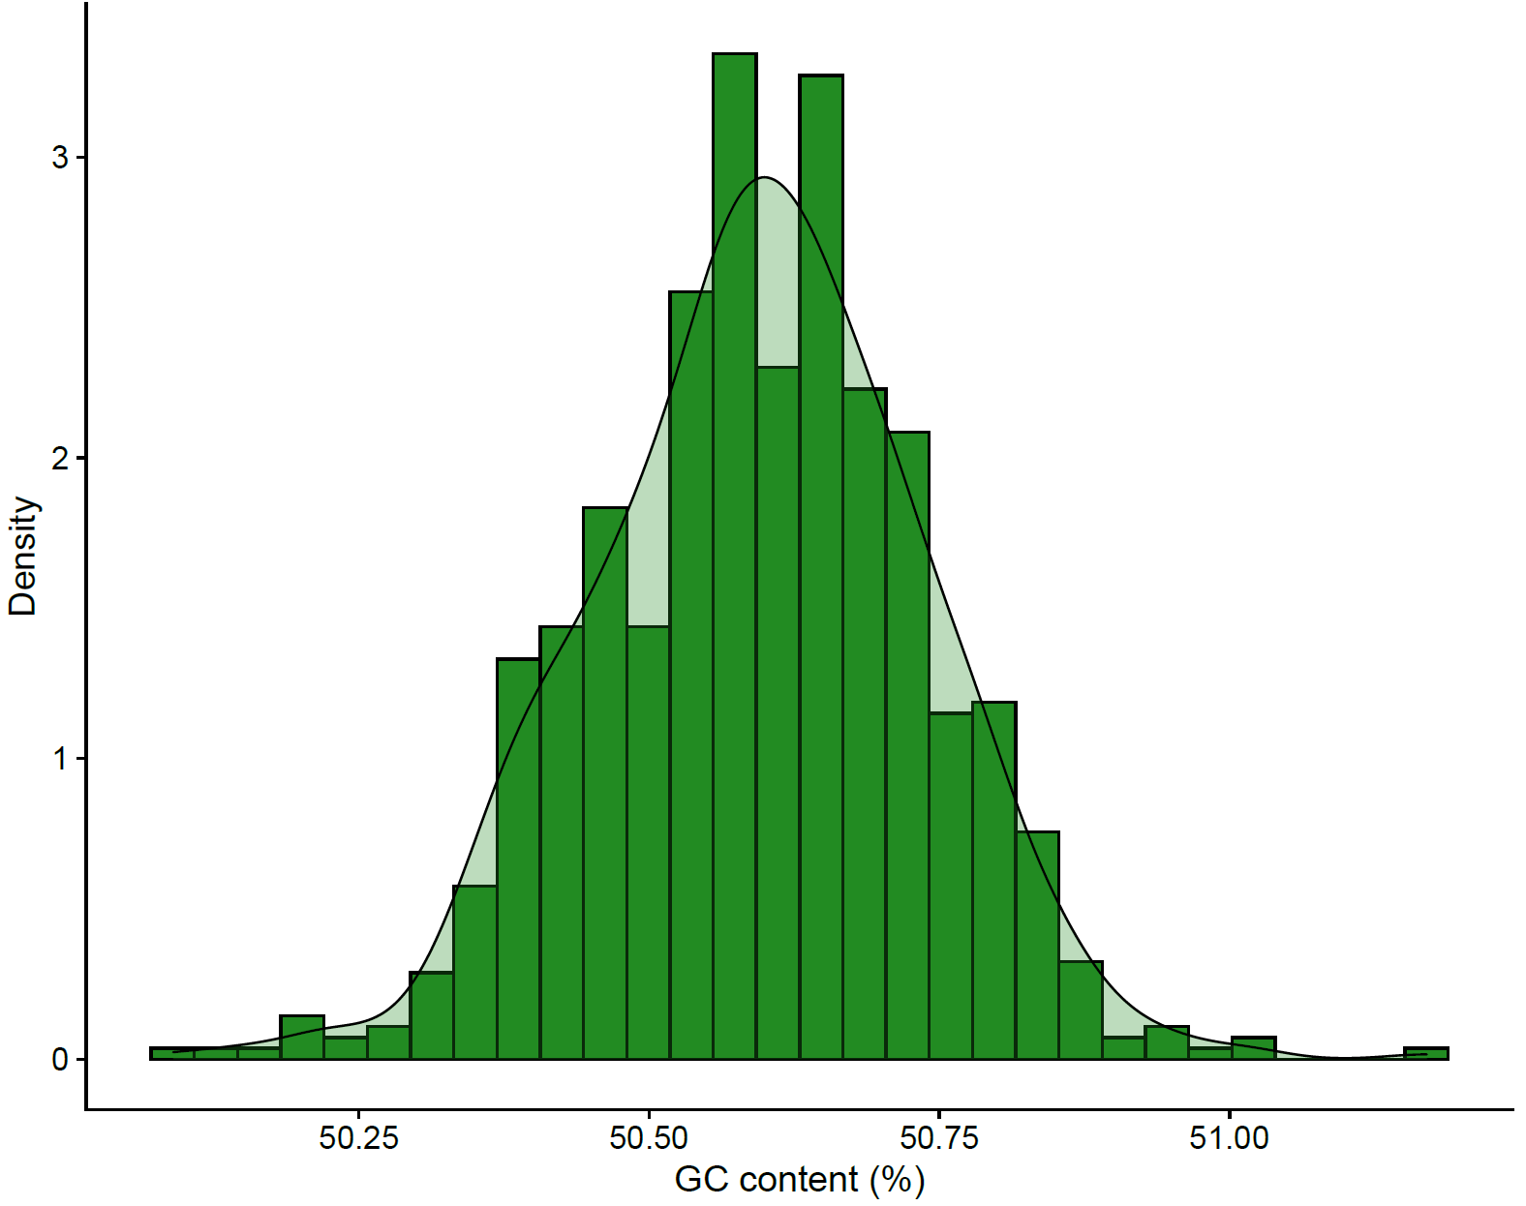
Genome size and GC content have a negative correlation
~5 Mb average
~ 50.6% average

Slide 16
E. coli pangenome shows a U-shaped distribution of gene presence
Category | Description | Genes
Core genes | (99% <= strains <= 100%) | 2774
Soft core genes | (95% <= strains < 99%) | 430
Shell genes | (15% <= strains < 95%) | 2553
Cloud genes | (0% <= strains < 15%) | 22119
Total genes | (0% <= strains <= 100%) | 27876
Notes:
In this slide we can see that, when we analyse this collection of the 750 strains, we have a total number of genes close to the 28K. The core genome is around 2800, plus about 430 genes present in almost all strains, leave ~24K genes that could be considered rare within the pangenome.
The metabolic capabilities of these strains can be greatly different in similar conditions. But how different?

Slide 17
What are the known and unknown functions?
Notes:
Is it true that we are navigating in the dark and we don’t really know the function of about 70% of these genes? Well, no. There’s a mix of missannotation and truly unknown function as we’ll see.
More thank known, we should say annotated and not annotated.

Slide 18
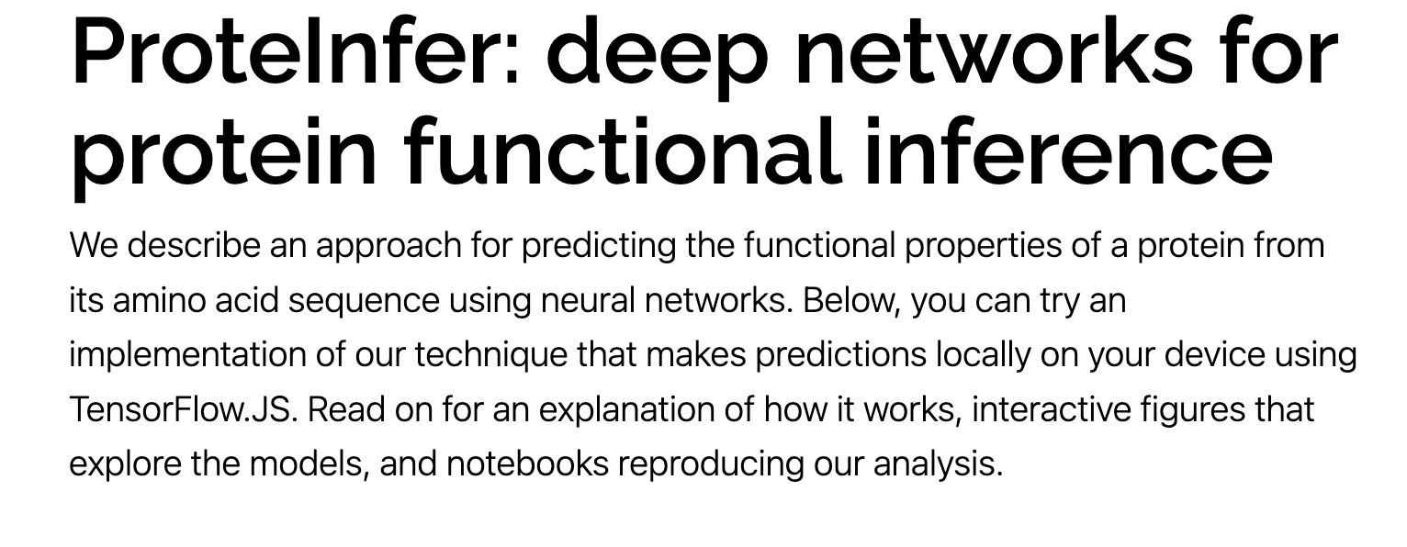
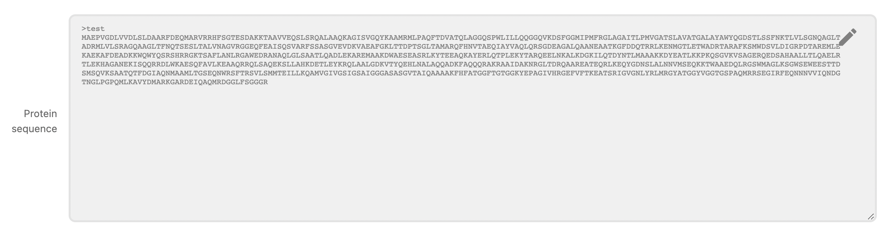
You can Google your protein function

Slide 19
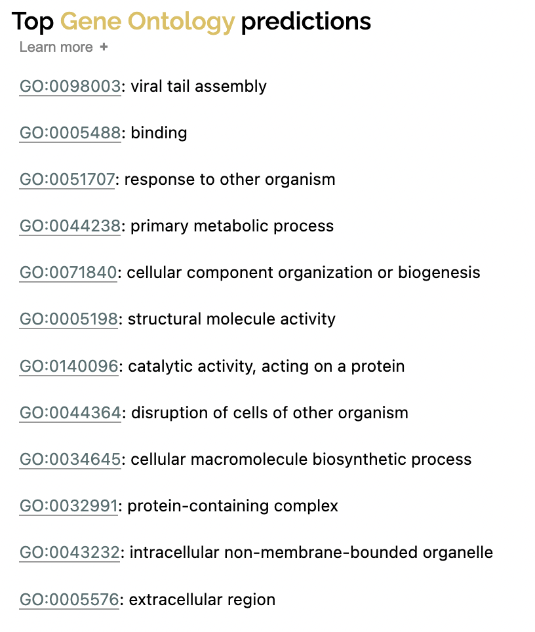
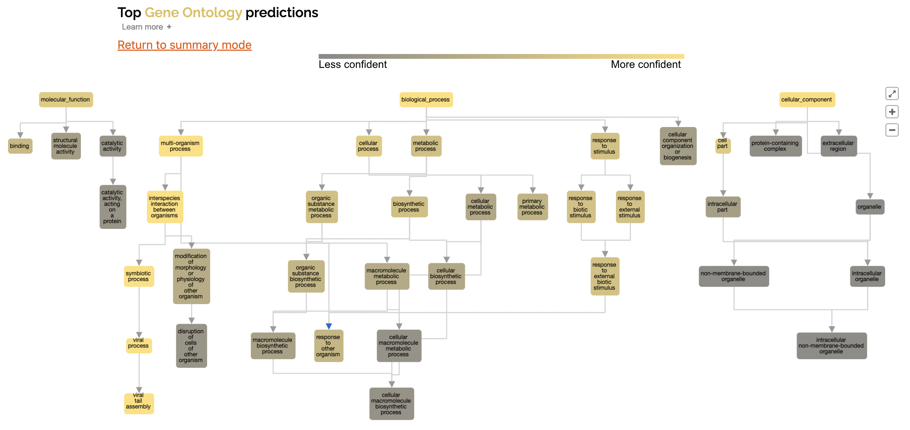
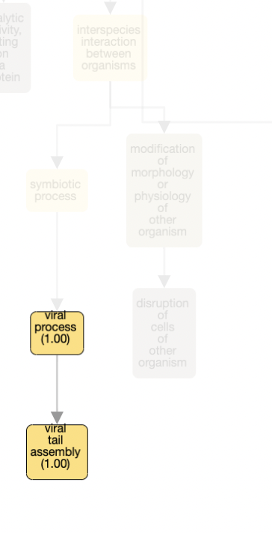
You can Google your protein function

Slide 20
The E. coli phylogenetic tree shows concordance with established phylogroups
B1
C
E
A
D
G
F
B2

Slide 21
Gene P/A PCA plot
Phylogroups tree
F
D
E
B2
B1
C
A

Slide 22
Strain distribution across phylogroups

Slide 23
Strain distribution across phylogroups and phenotype

Slide 24
Adding all the information together in a phylogeny shows some trends

Slide 25
Genome size and GC content have a negative correlation
Genome size
GC content

Slide 26
Annotation

Slide 27
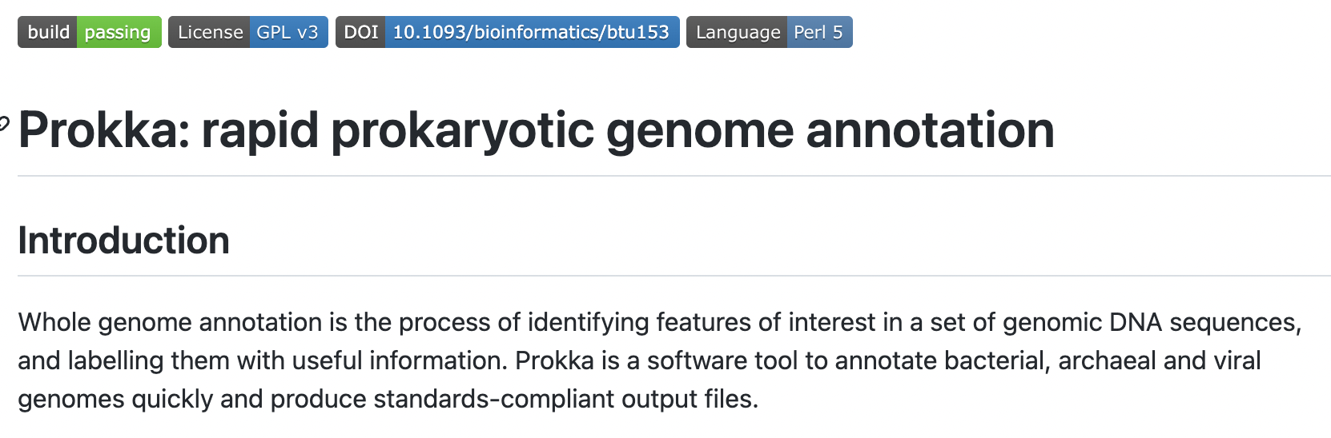
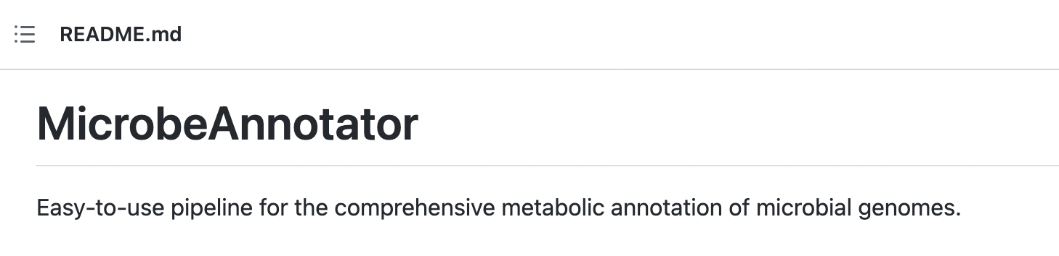
An essential part of the pipeline presents some challenges
Pros
Cons
-Last update was >2 yr ago
-Can make some mistakes
-Outdated databases by default
-Very easy to use and fast
-Don’t use many resources
-Useful output for pipelines
Pros
Cons
-Much better db for annot.
-Newer and better algorithms
-Nice summary of functional capabilities
-Hungry in resources
-It has not been updated in the last year
-Output files not useful for pipelines
Notes:
I need to keep looking for

Slide 28
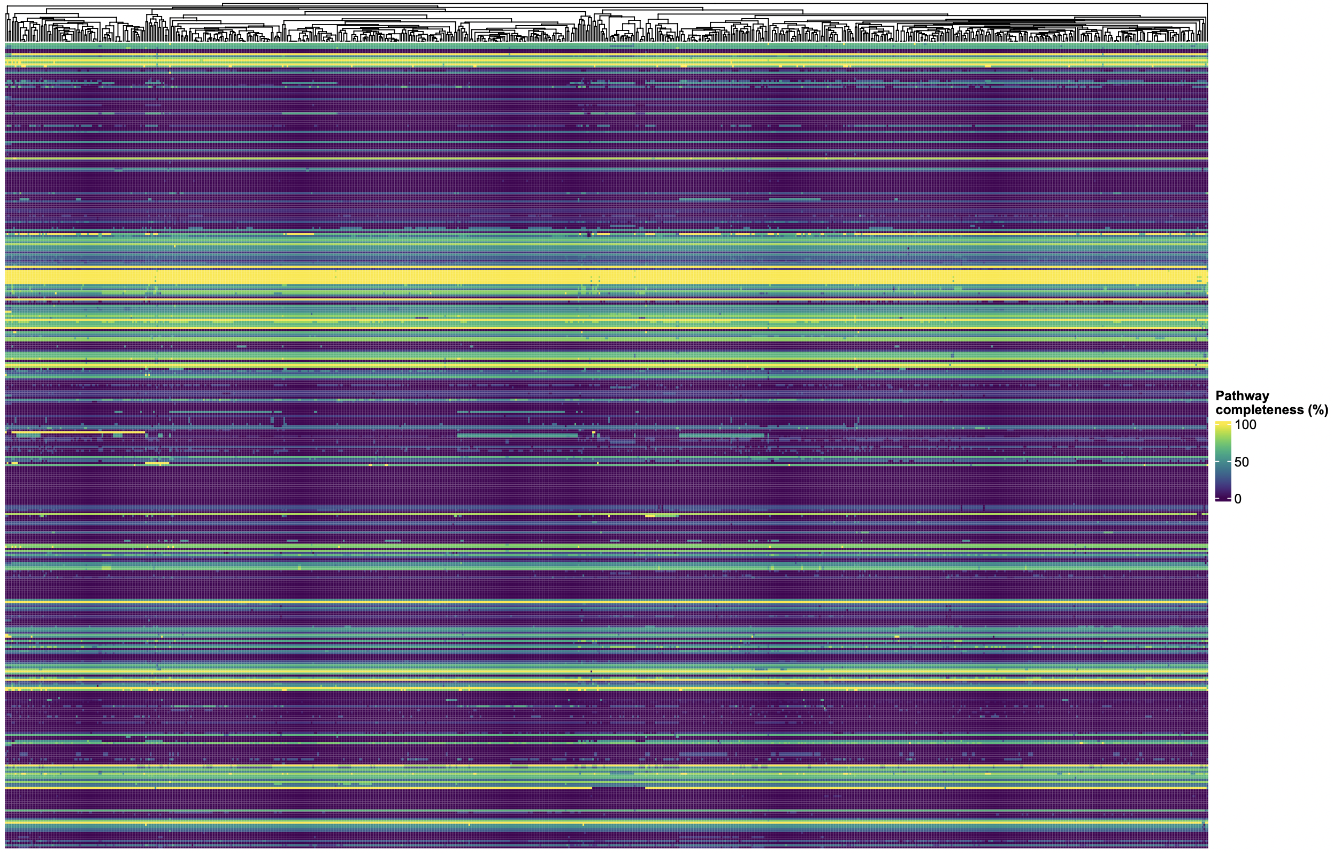
Metabolic structure of the pangenome

Slide 29
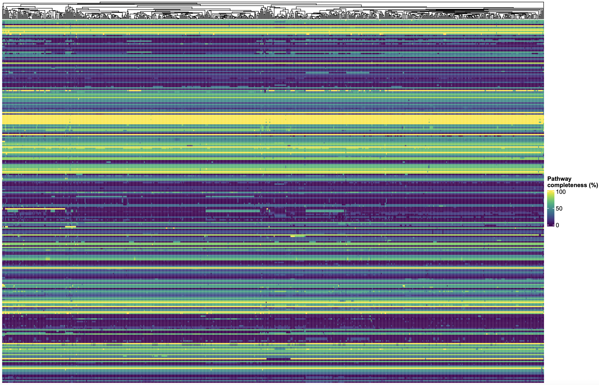
Metabolic structure of the pangenome
Filtering the heatmap to show only modules with mean > 0% and std > 0%
We start seeing some “patches”

Slide 30
Metabolic structure of the pangenome

Slide 31
Metabolic structure of the pangenome

Slide 32
Prophages

Slide 33

Test with Pro-phage hunter
Webtool (so is quite slow to use in high-throughput)
Hypothesis: there are usually more prophages in pathogenic bacteria than in commensals.
Questions: is it true in our dataset? How many strains will have prophages in their genomes?
To test these questions, I took 9 strains from each of the 3 main bacterial phenotypes: commensals, pathogens and lab strains from the ECOREF collection

Slide 34
Prophages found in a subset of our genomes

Slide 35
Prophages found in a subset of our genomes

Slide 36
Prophages found in a subset of our genomes
Notes:
A few take-home messages from this part is that even the strains we consider to be commensals could not be under some conditions.
Also, we have a very rich diversity of prophages in this small subset of genomes. Surely the number of different prophages will be established when more genomes are added to the analysis, but still this is something we need to take into consideration.
I need to look

Slide 37
Biosynthetic Gene Clusters

Slide 38
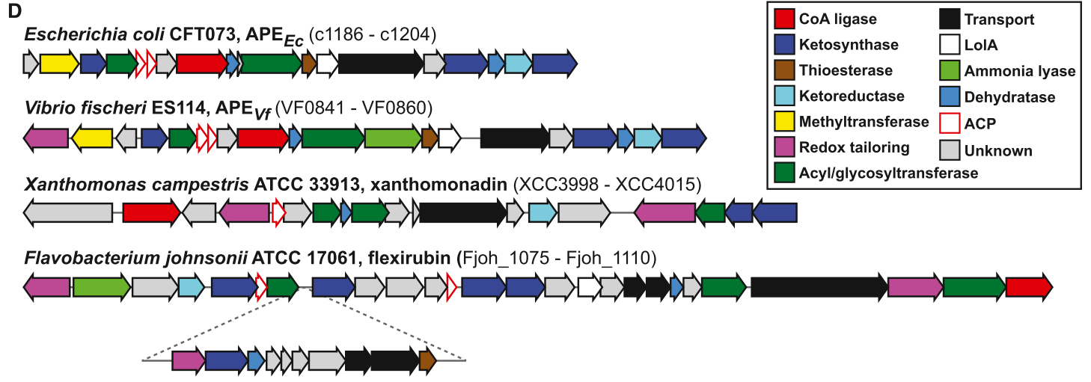
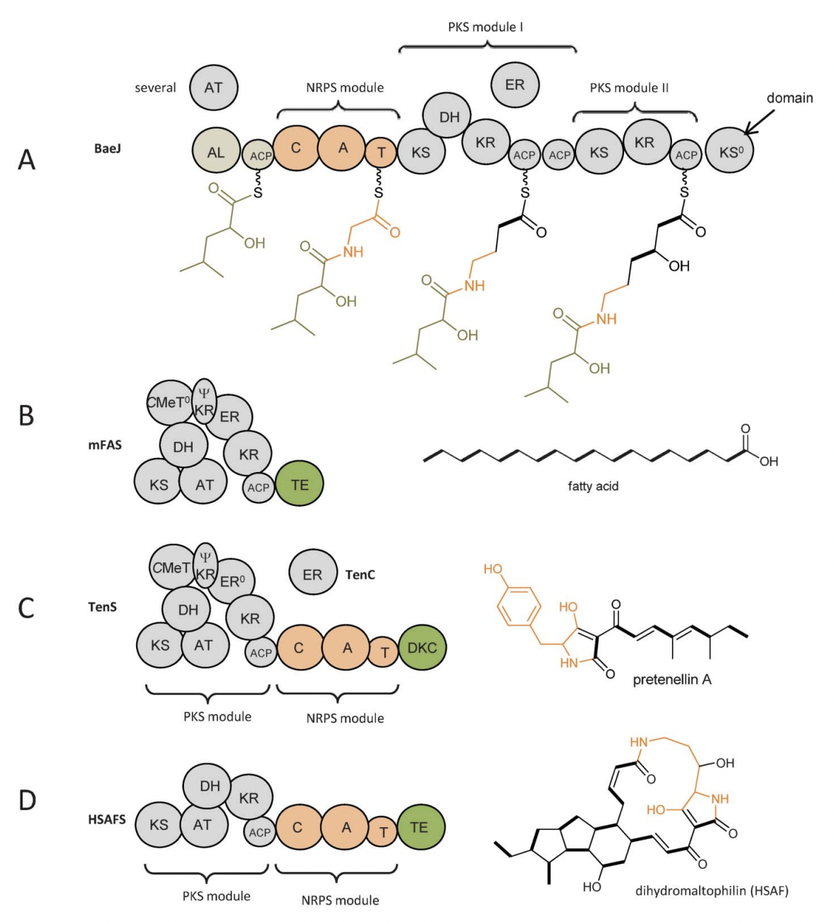
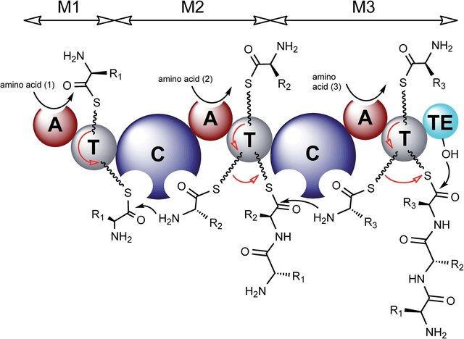
Introduction – An example of an NRPS building line
Notes:
First step: activation
Second: thiolation domain
Final step: condensation
Terminal step to finish the molecule (thiesterase domain)

Slide 39
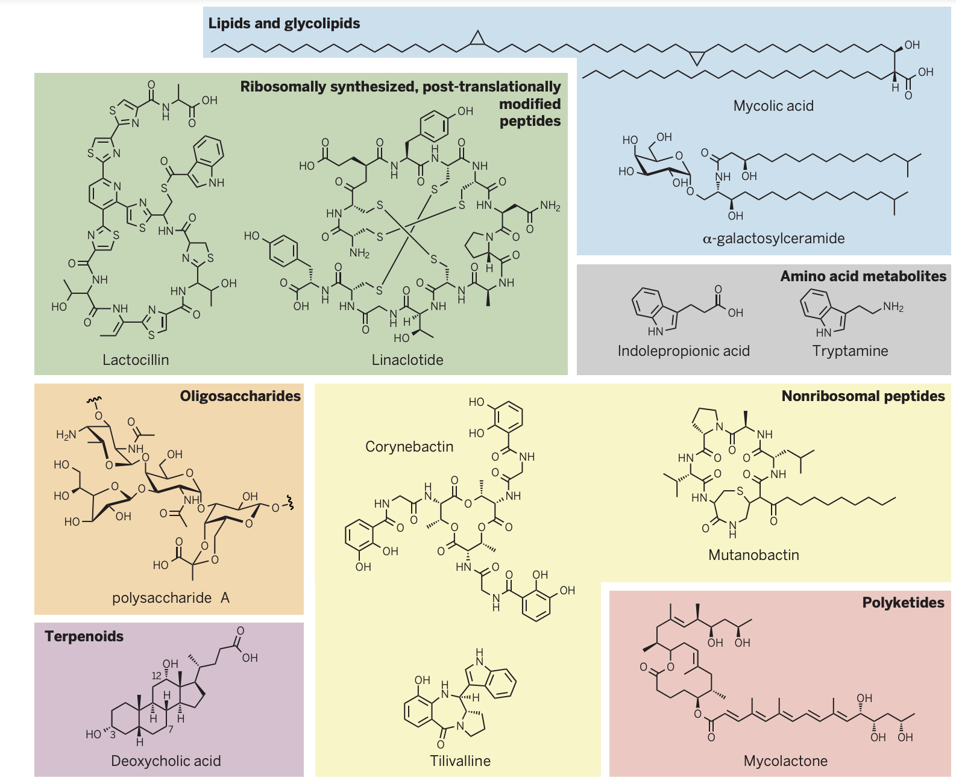
Introduction – BGCs: arming microbes with different toolboxes
What are the BGCs encoded in a big pangenome as the one from E. coli?
How is the distribution of these BGCs in our collection?
Can we predict the products that are potentially synthesized?
Can we learn the biological relevance of these compounds?

Slide 40
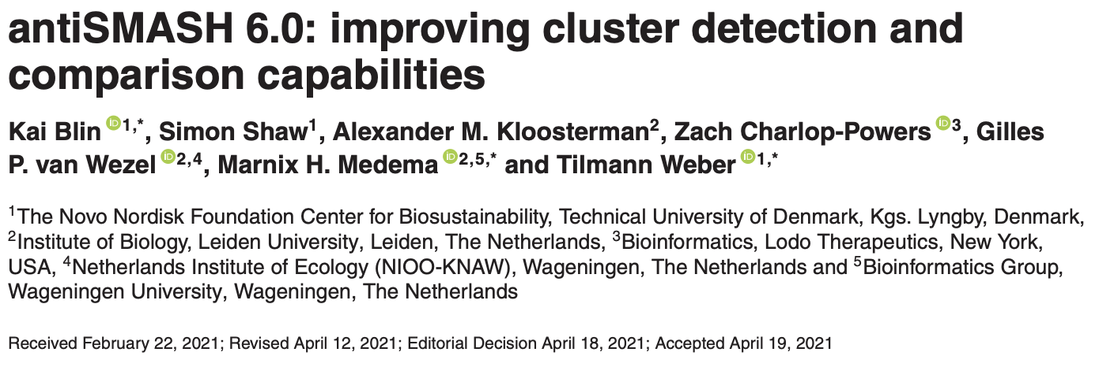

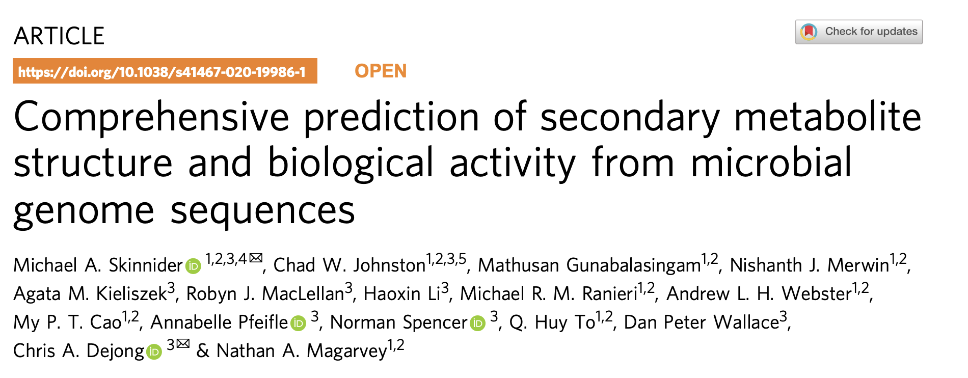

Two methods to study BGCs

Slide 41
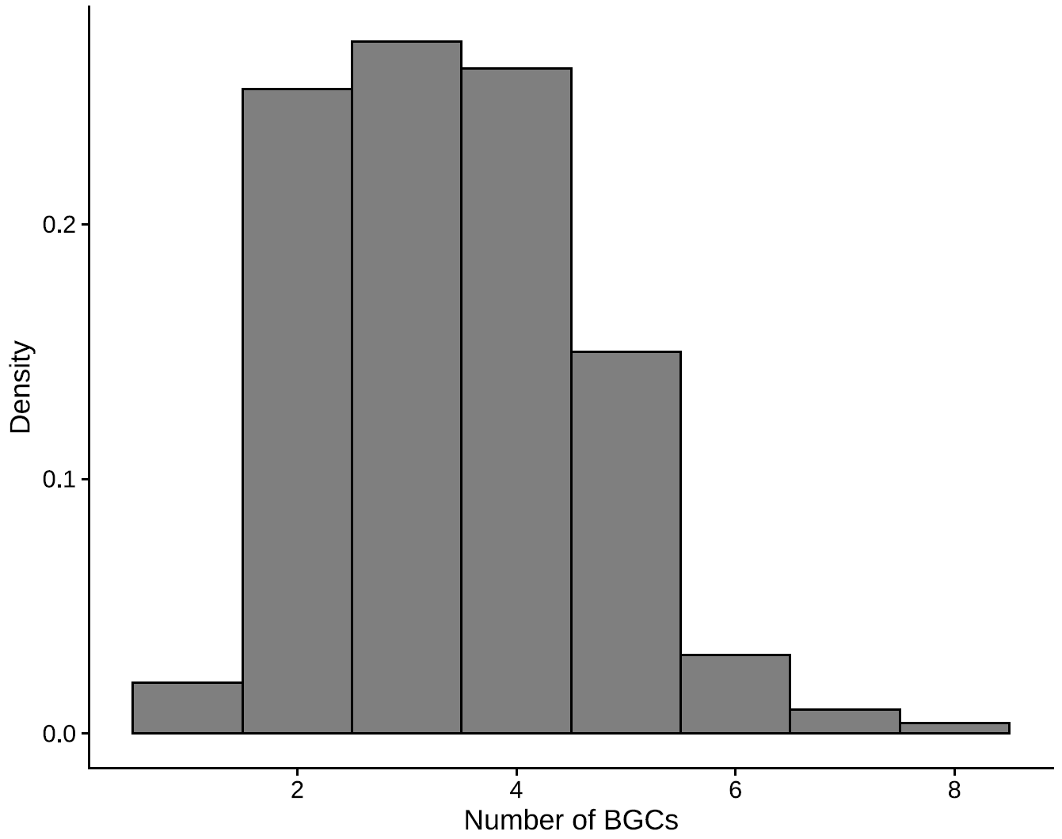
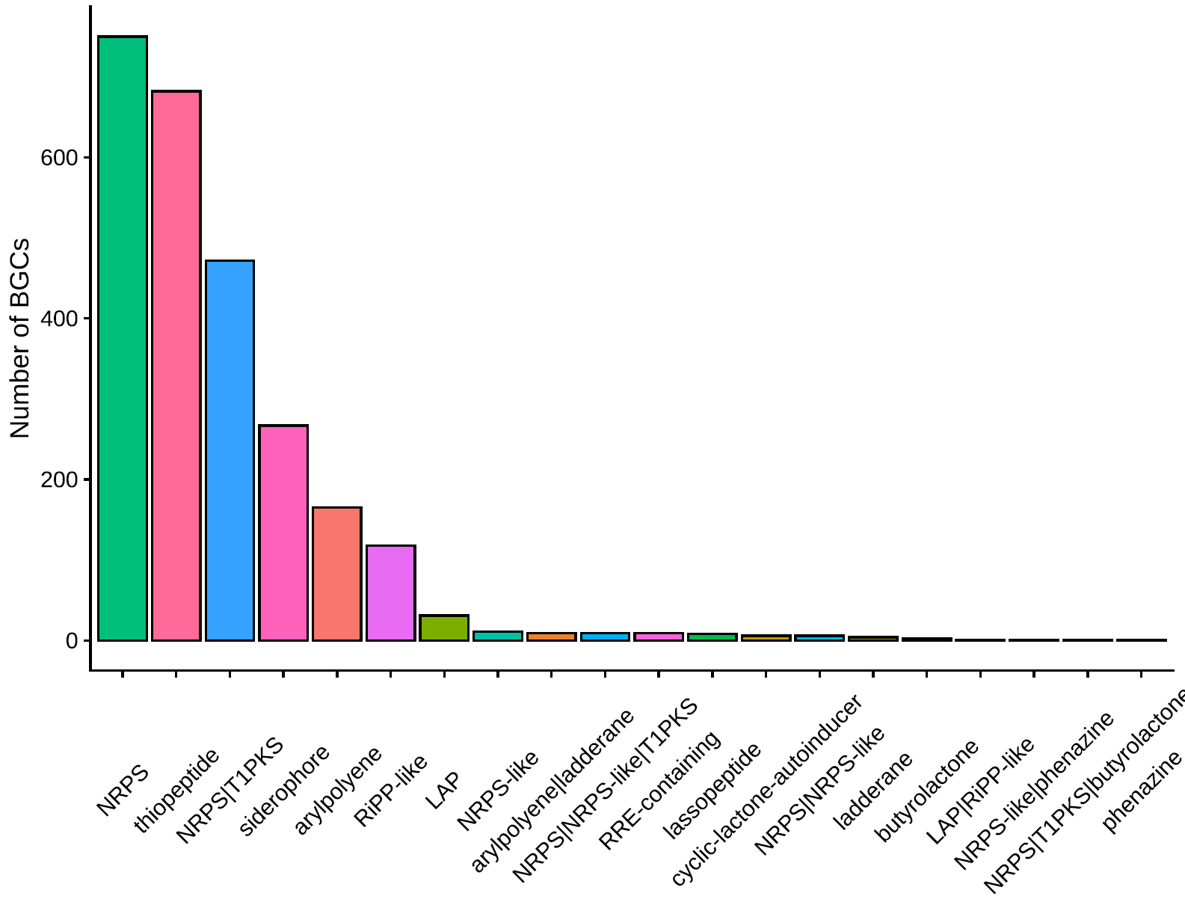
BGC distribution
Notes:
NRPS: non-ribosomal peptides

Slide 42
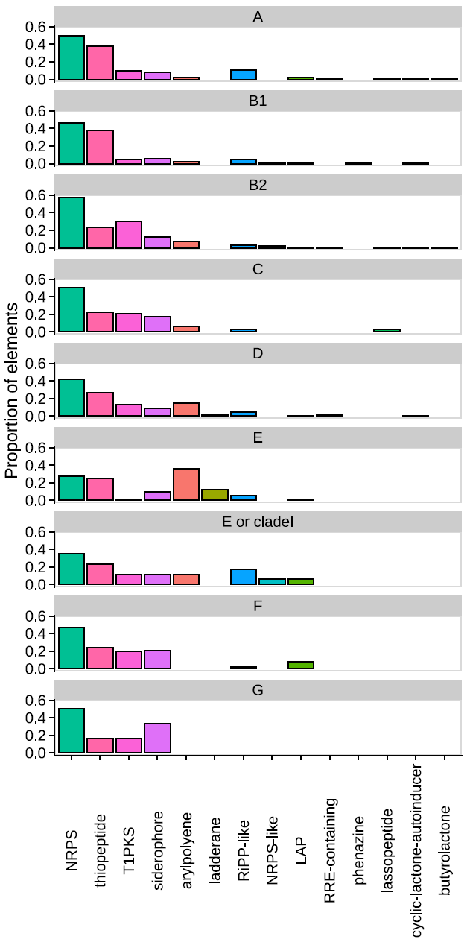
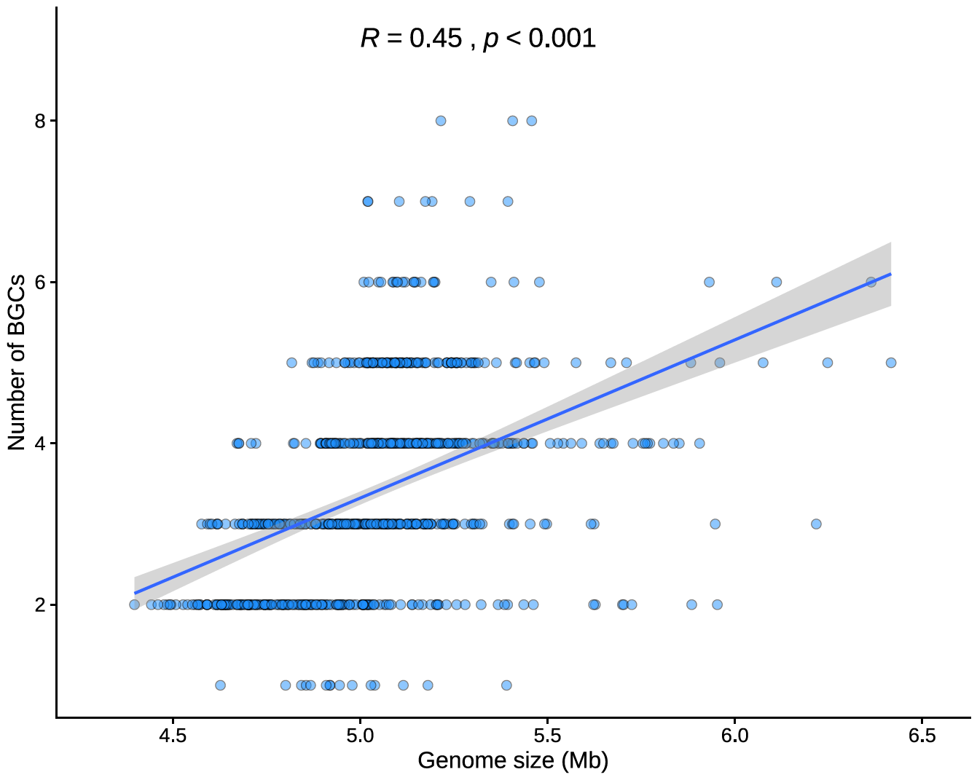
BGC distribution

Slide 43
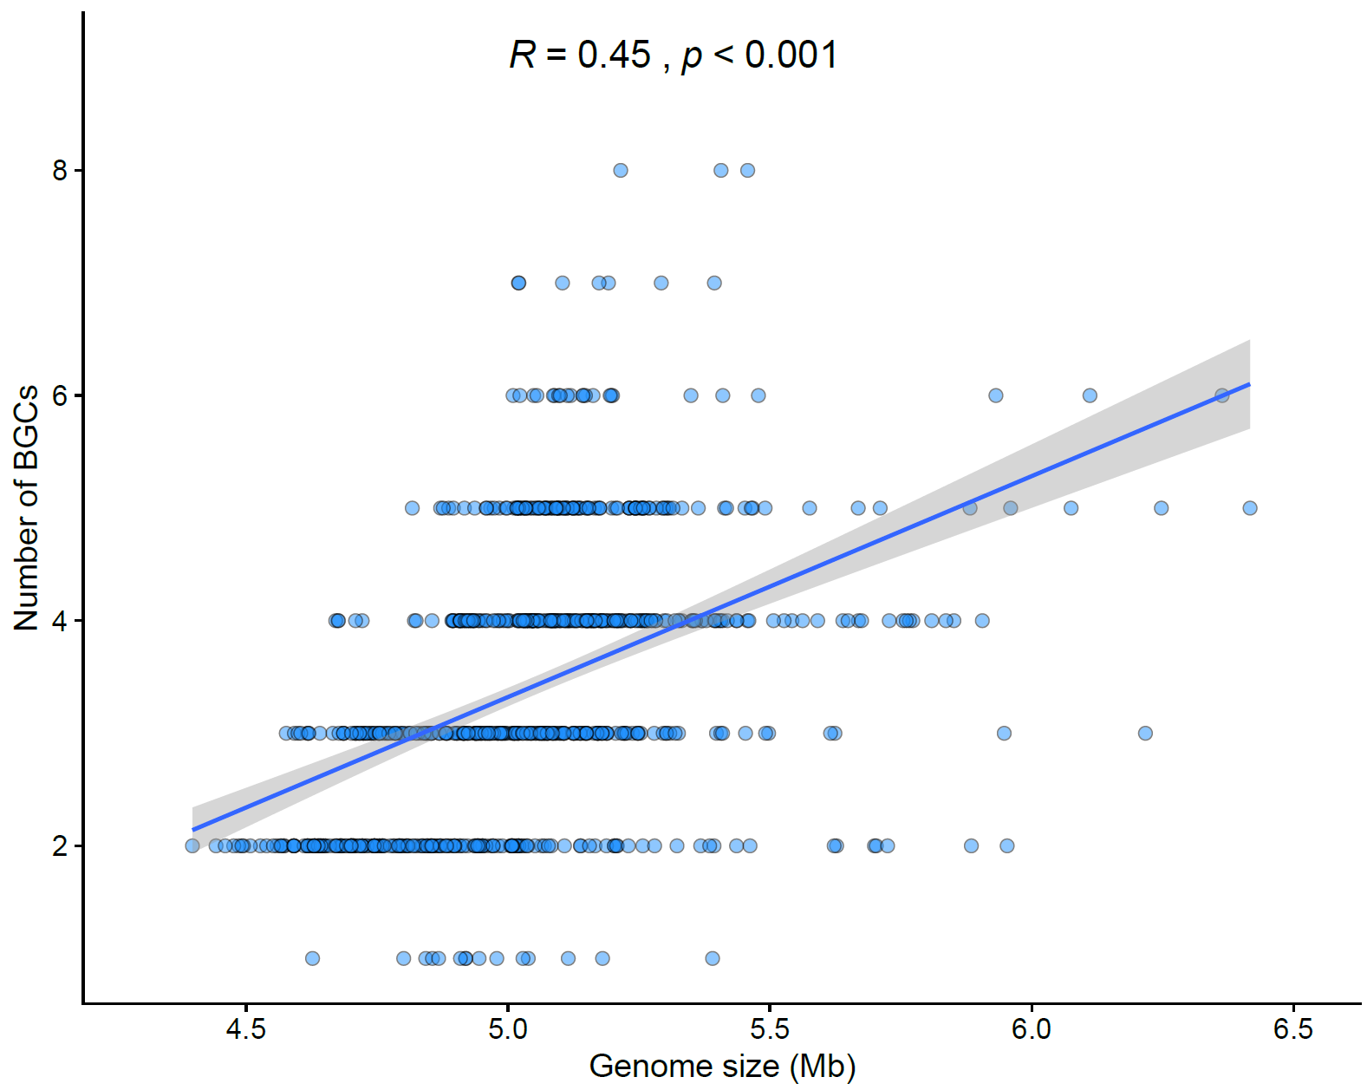
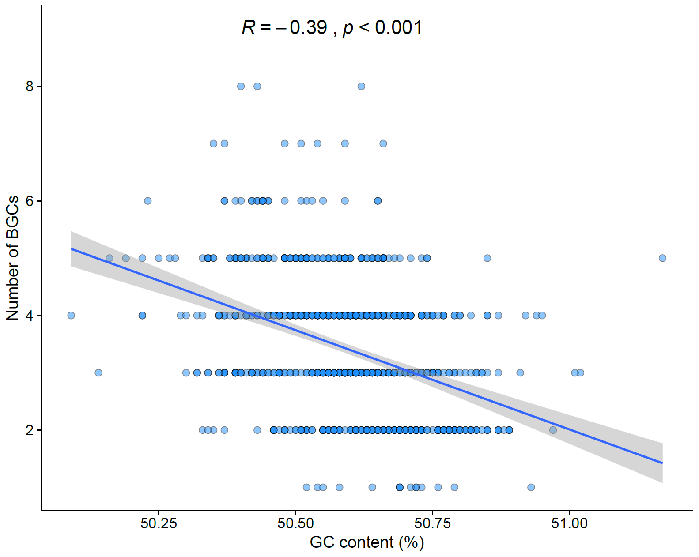
BGC distribution
Weird!

Slide 44
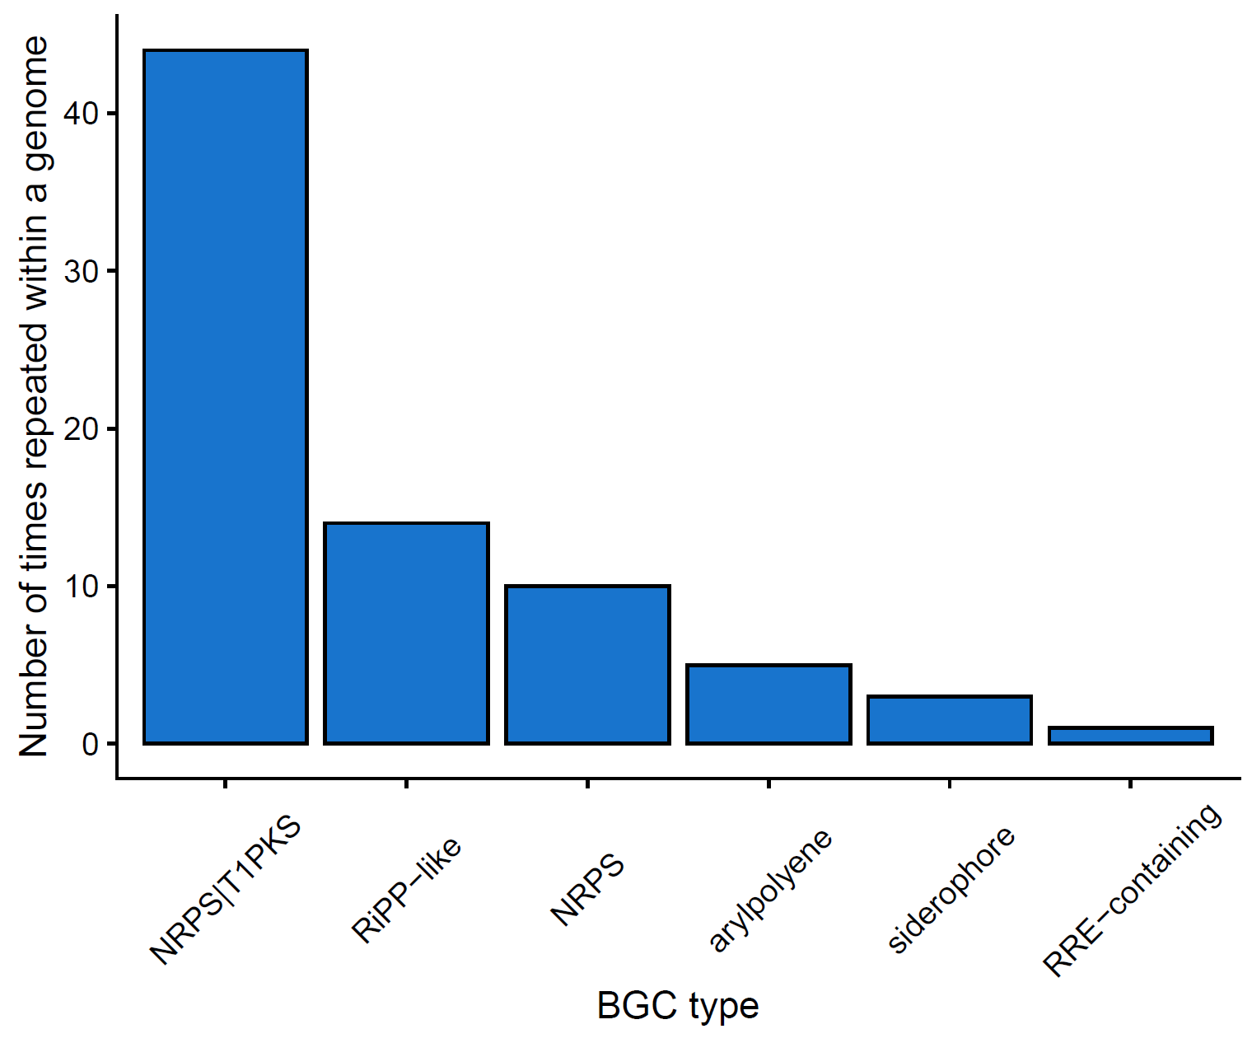
BGC are repeated in some genomes
Some BGCs are repeated within the same genome.
This plots represent the BGC type that are most repeated across the 746 genomes

Slide 45
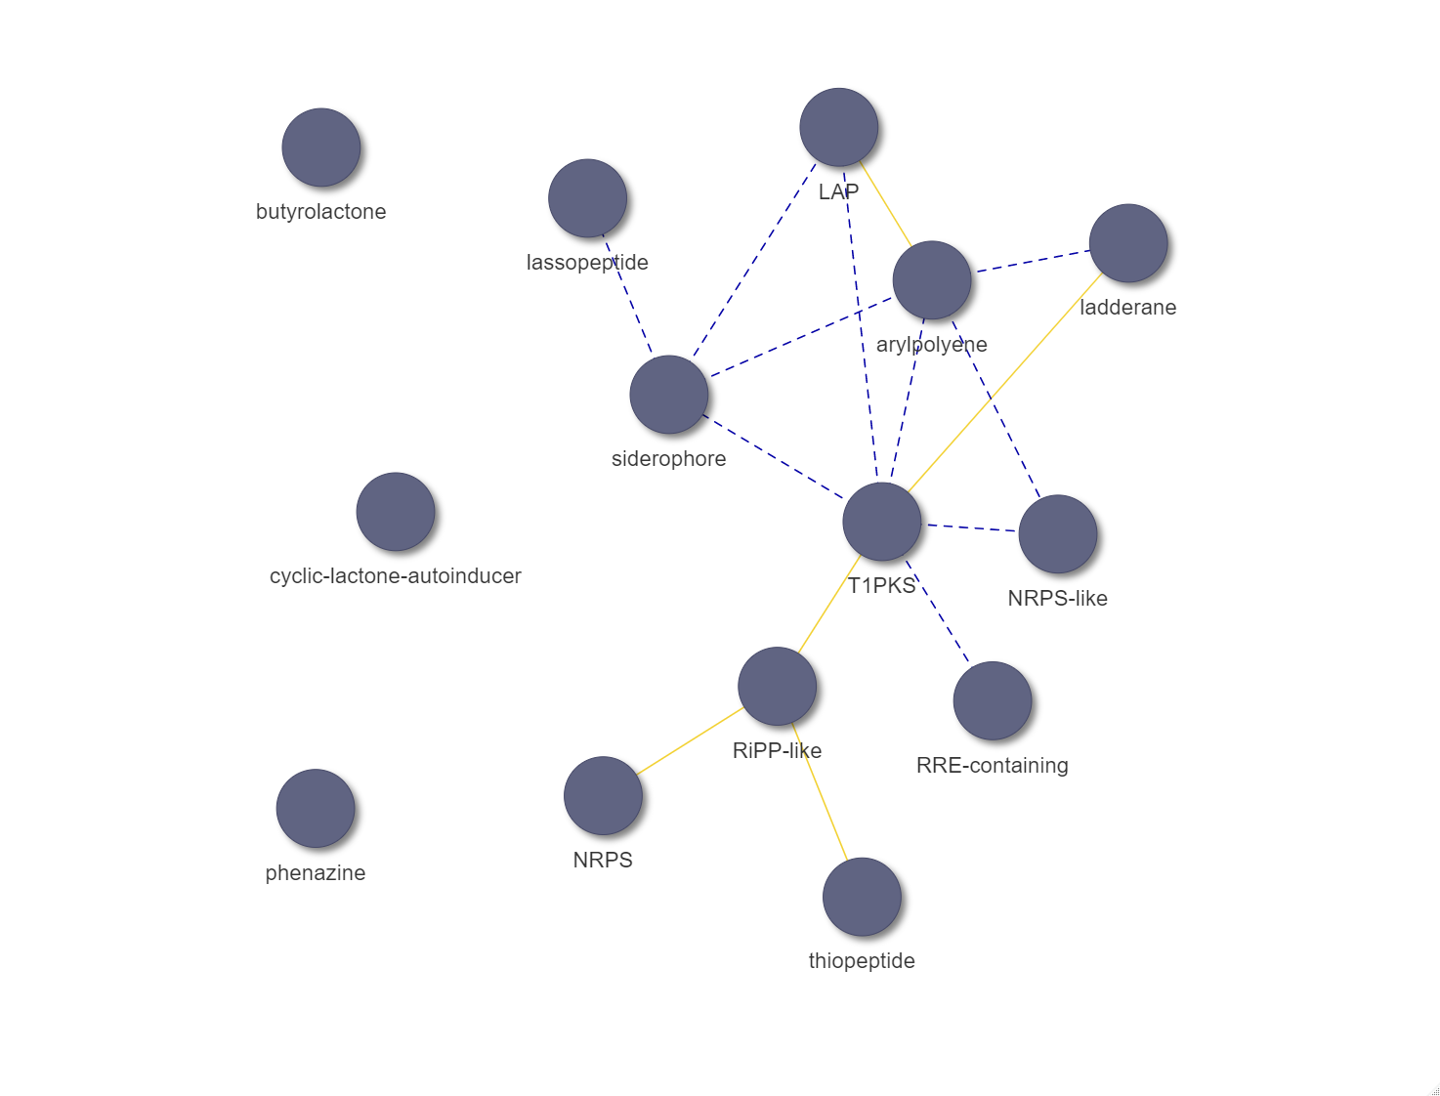
BGC co-occurrence analysis
Some BGCs usually are present when another class is present. This is easily studied by co-occurrence analysis, as represented by this network.
Yellow lines = significant relations
Notes:
NRPS co-occur with RiPP-like (Ribosomally synthesised and post-translationally modified peptides), which also co-occurs with thiopeptides and T1PKS, which is co-occurring with the ladderane class. Arylpolyenes co-occur with LAP (a class of RiPP)

Slide 46
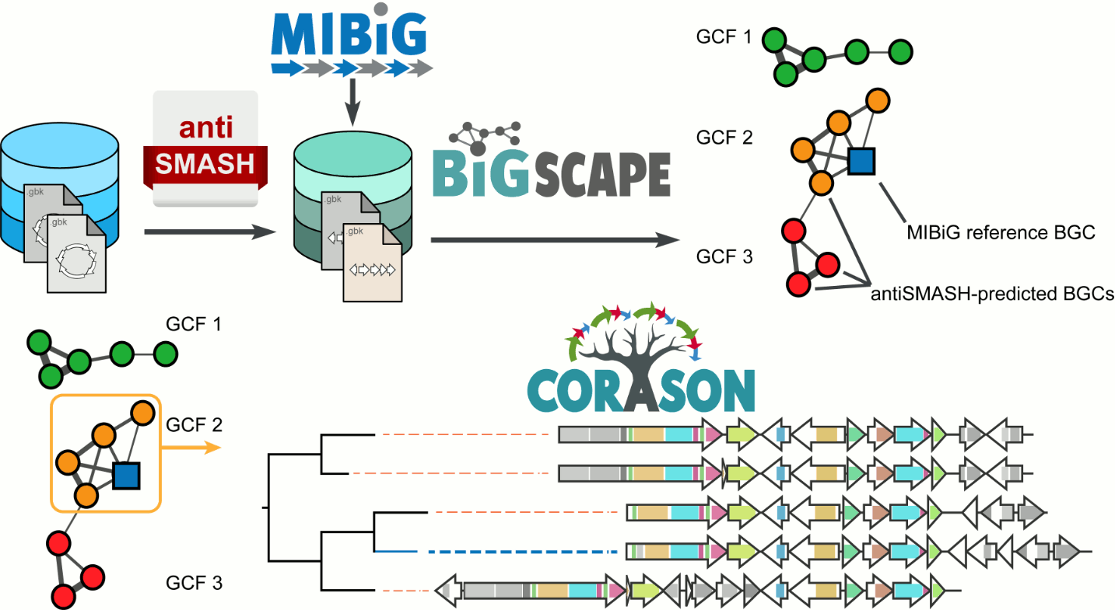
Studying the structure of the BGC families and clusters

Slide 47
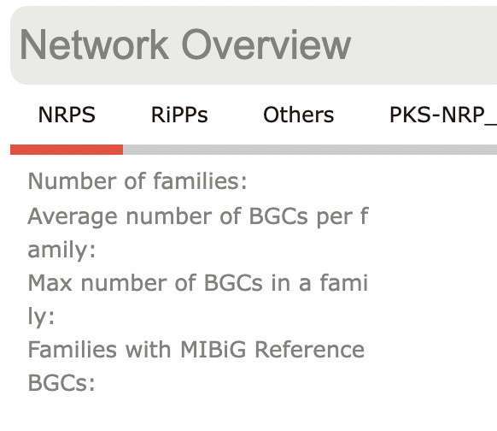
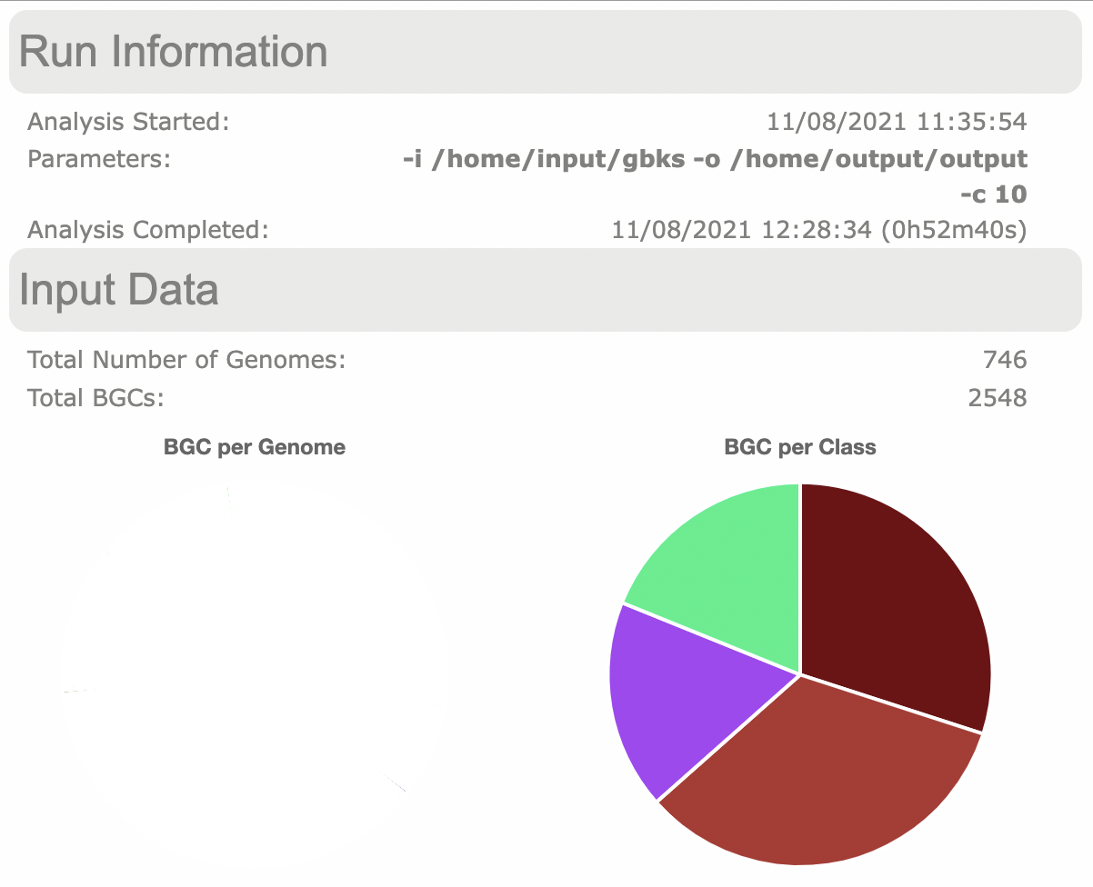
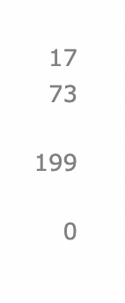
Studying the structure of the BGC families and clusters
2548
PKS-NRP
NRPS
Others
RiPPs
Notes:
The fact that there are 0 Families with MIBiG references means that I need to re-run the analysis with different parameters

Slide 48
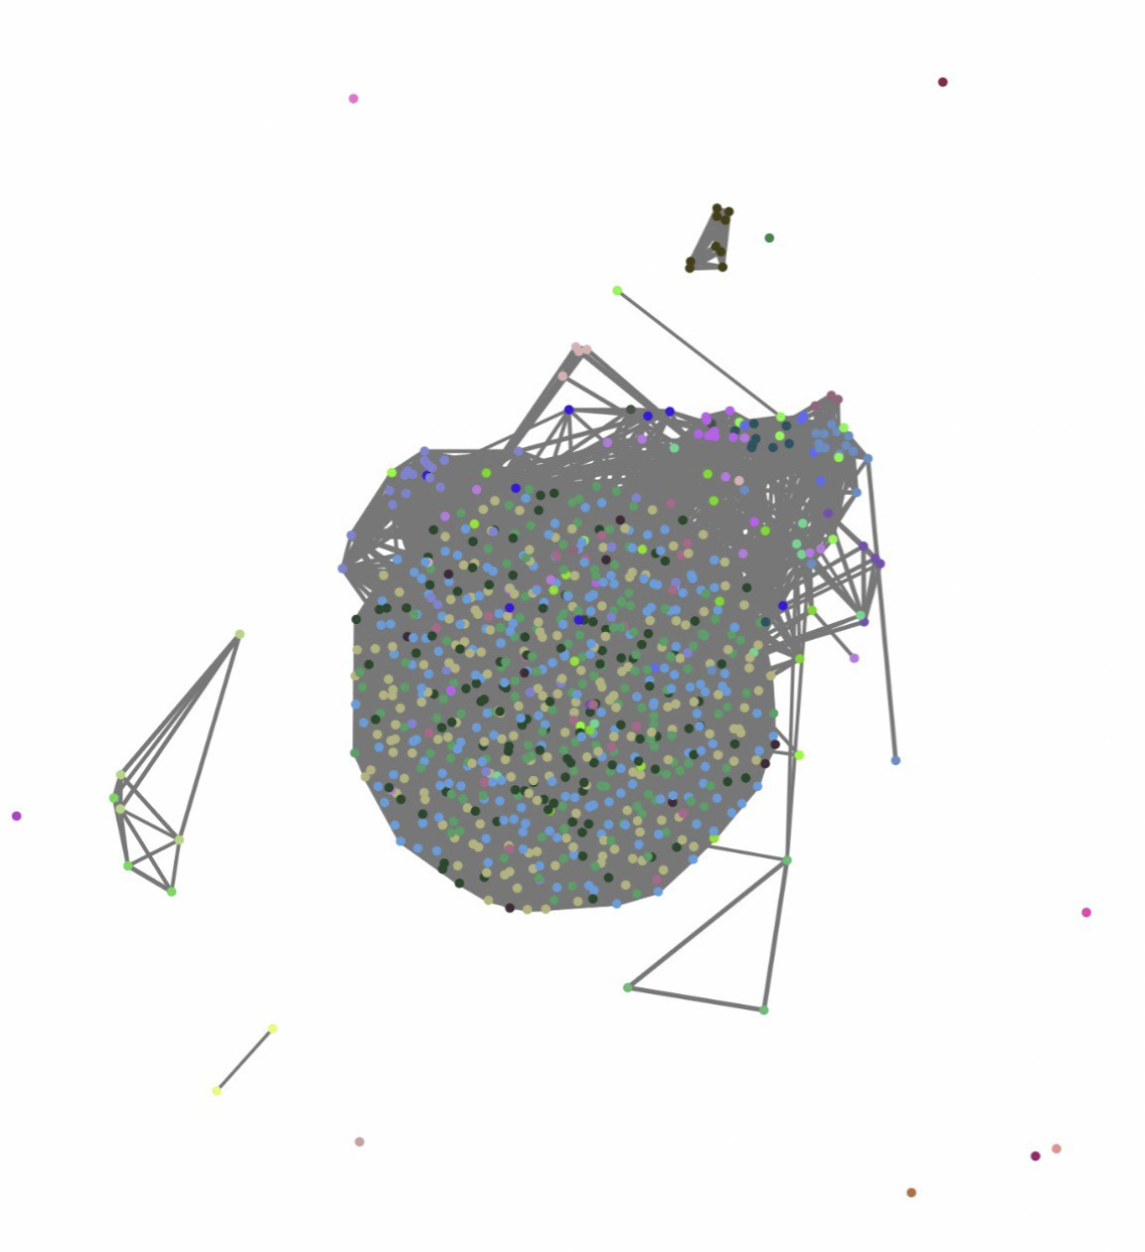
Studying the structure of the BGC families and clusters
Example of the PKS group
Notes:
Need to see how these families are distributed in the context of different variables here:
Bacterial information: phylogroups, bac broad phenotypes, bact quant phenotypes, sources…
Worm phenotype

Slide 49
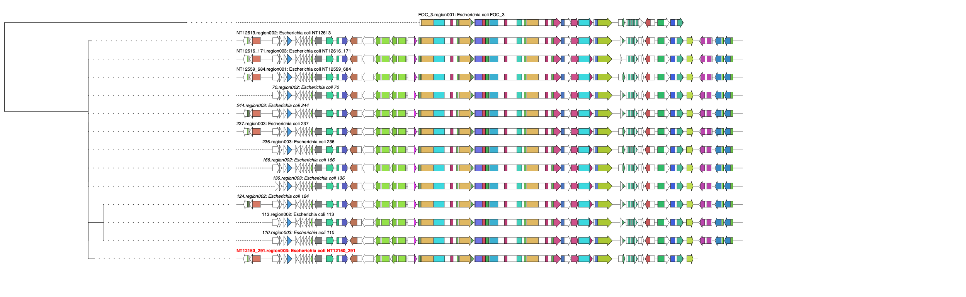
Exploring the BGC families encoded in a pangenome

Slide 50
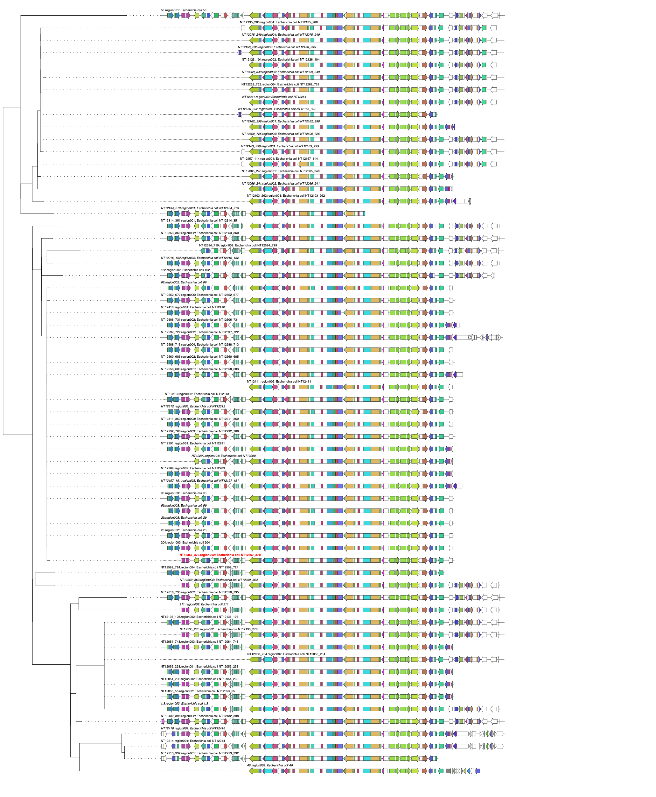
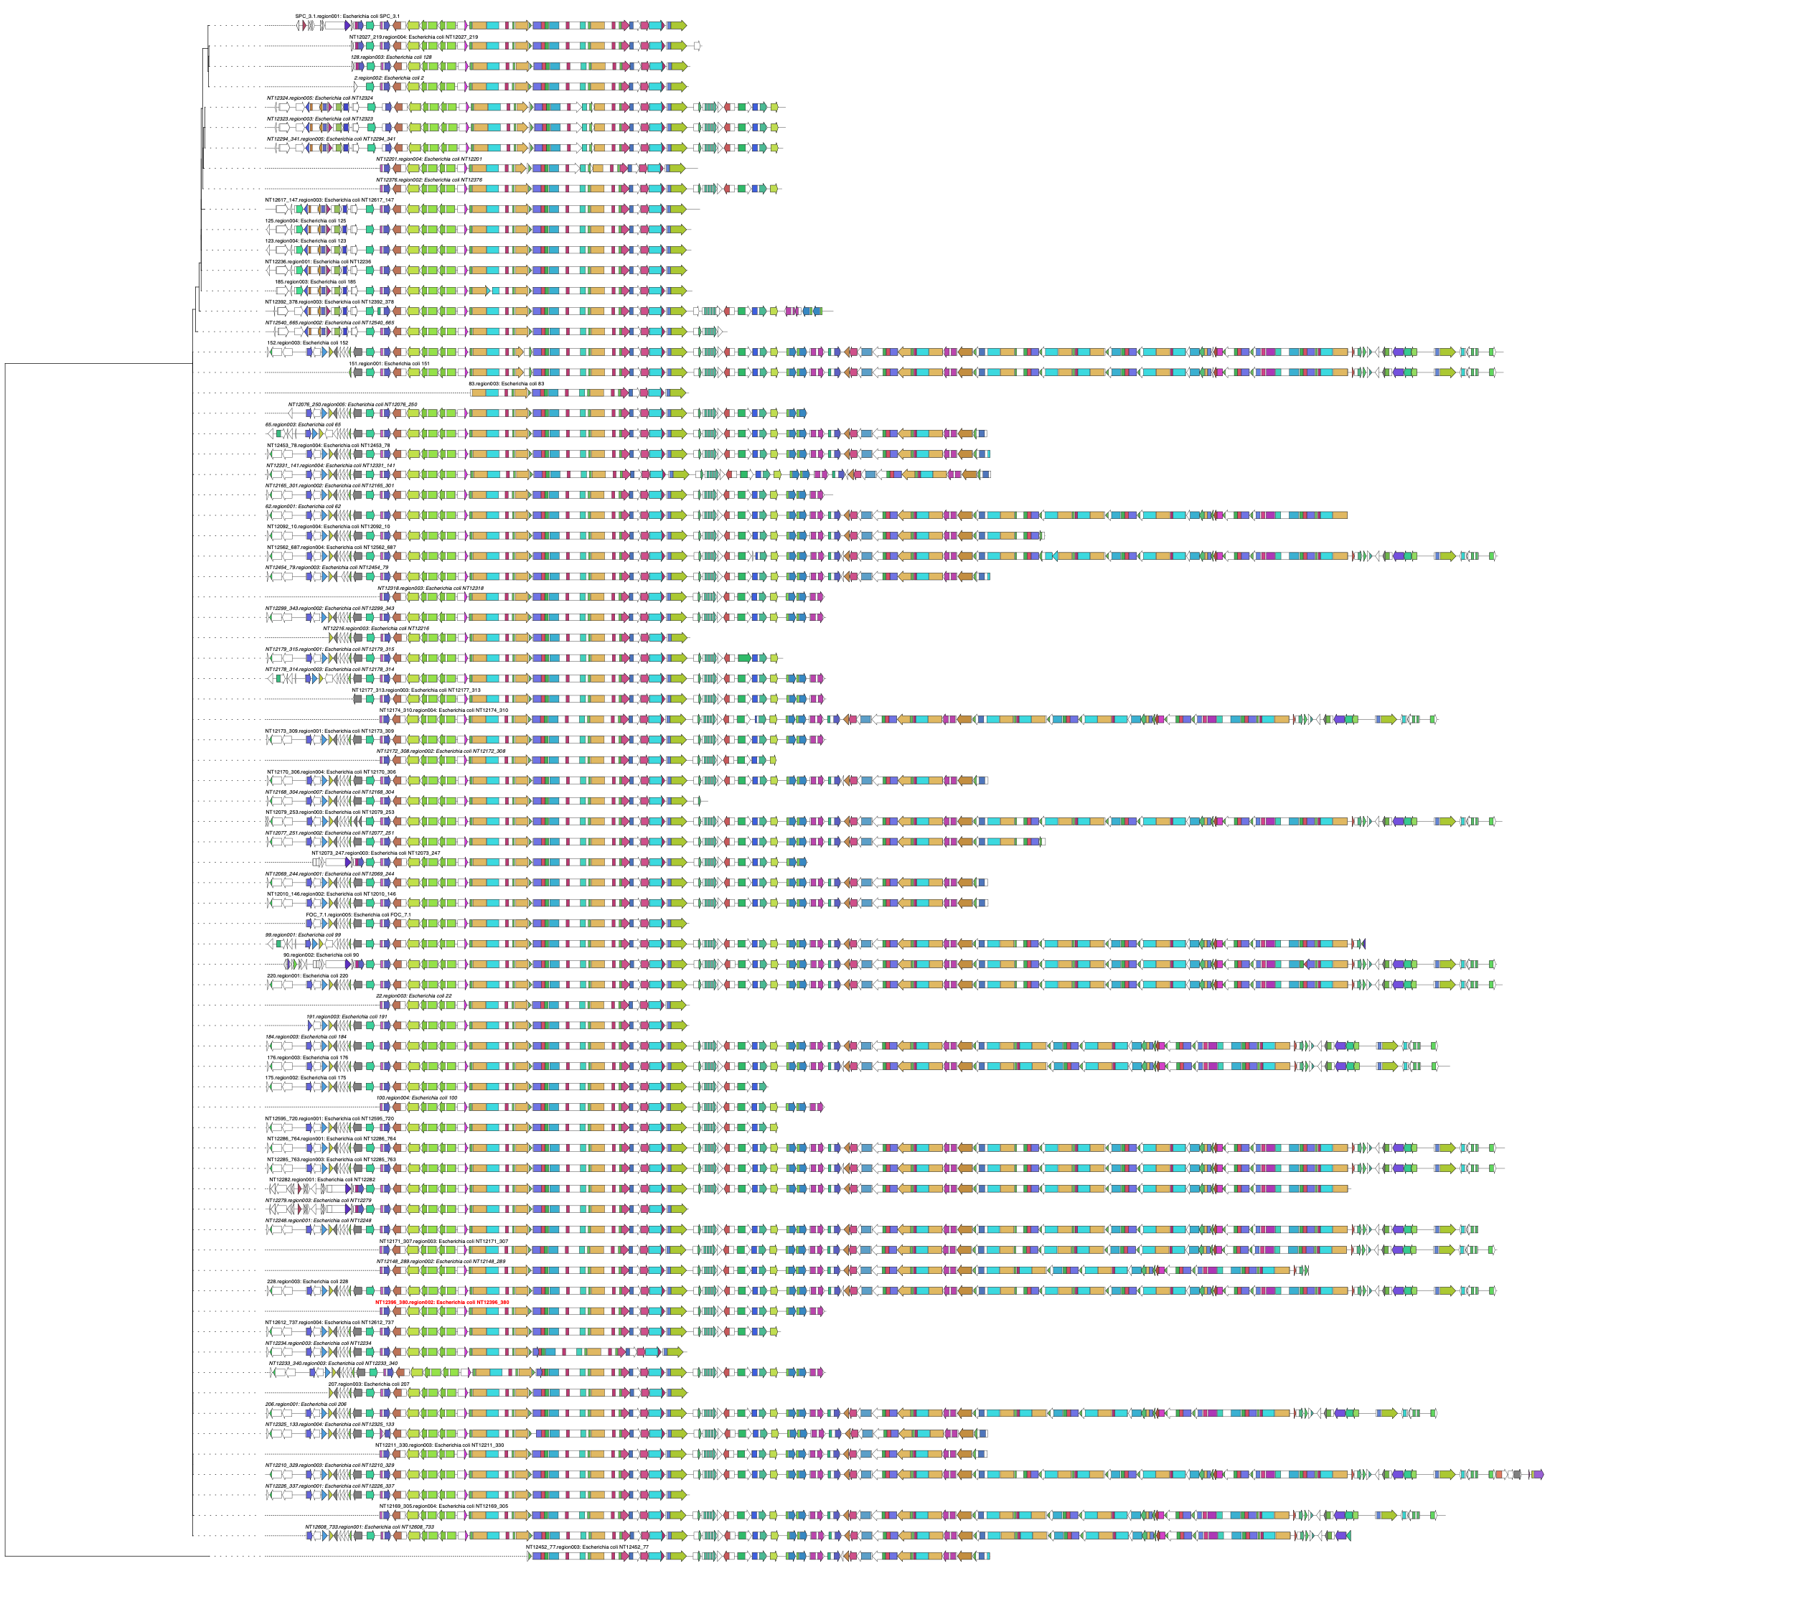
Exploring the BGC families encoded in a pangenome

Slide 51
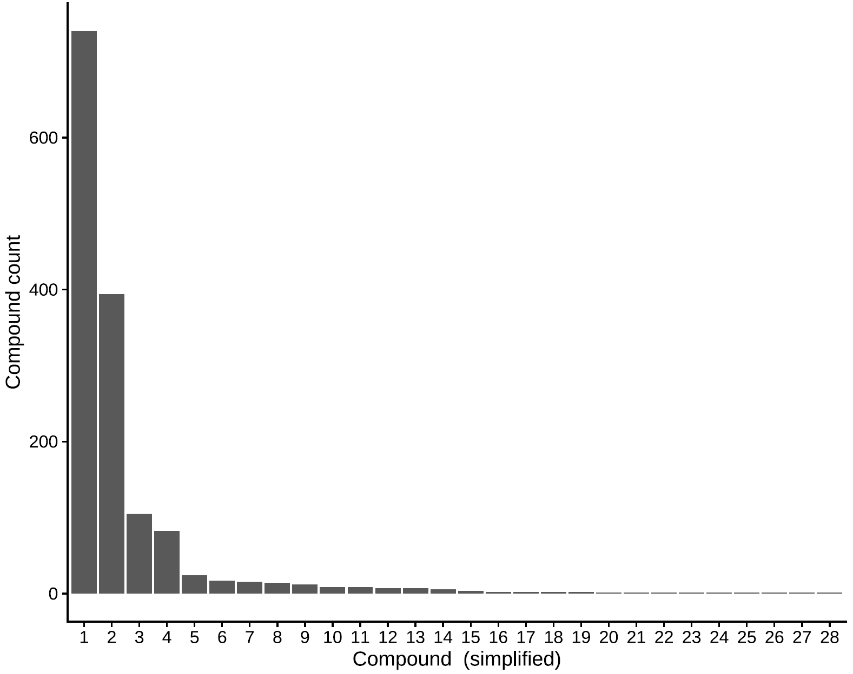
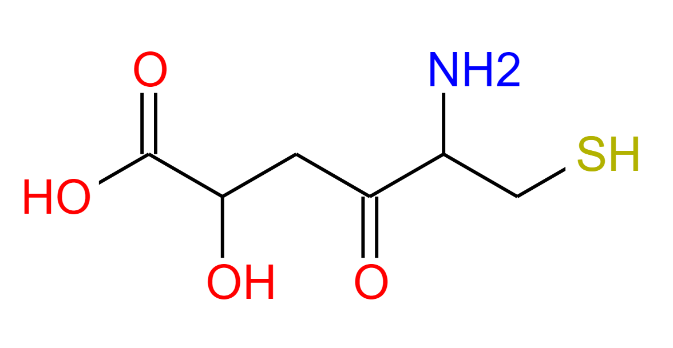
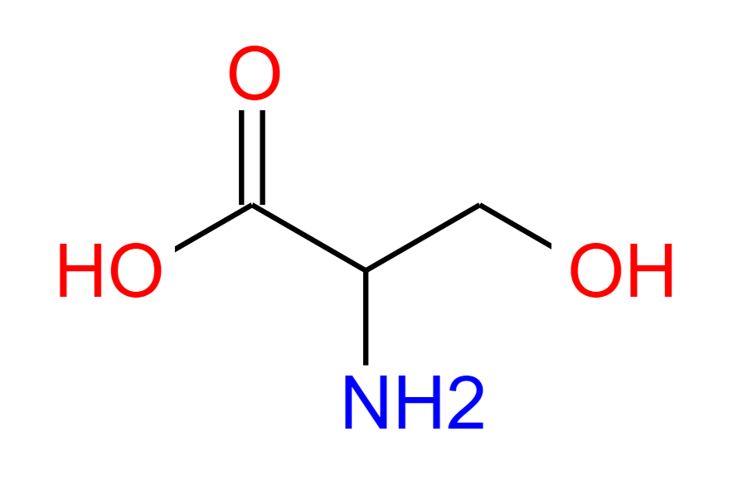
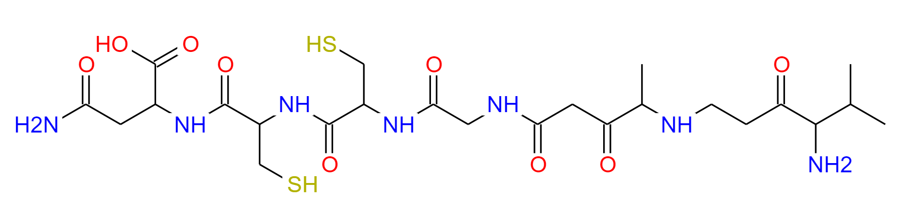

Metabolic potential of the E. coli pangenome
1.
2.
3.
4.

Slide 52





Metabolic potential of the E. coli pangenome
1.
2,3-Dihydroxy-n-benzoylserine
2
3
9
Lasso peptides

Slide 53



How we do make sense of the chemical compounds?

Slide 54

Chemical Checker

Slide 55


Slide 56


Slide 57

The case of the genome 107

Slide 58


The case of the genome 107
Colibactin!
But my annotation shows the name of dltA_2 instead
Running blast on the protein sequence (BlastP) shows that this is clbK!
Notes:
I need to sit down and learn how to do blast locally, it seems.

Slide 60
What is left to do:
de-duplicate strains in the dataset (there might be a few that are (almost) exactly the same)
Match genomes to known strains in db (using tools like Kraken)
Improve Prokka annotation (training models with Prodigal)
Identification of antimicrobial and virulence genes

Slide 61
Microbial GWAS

Slide 62





Microbial GWAS
GWAS
mdGWAS
mdhGWAS
Experimental Validation
(Tam V 2019, Nature Rev. Genetics)
(Power RA V 2016, Nature Rev. Genetics)

Slide 63


Microbial GWAS in the context of metformin

Slide 64


Microbial GWAS in the context of metformin
prgK

Slide 65


Exploring the unitigs (”k-mers”) of the pangenome
Snakemake pipeline ready to deal with any source of variability

Slide 66



Cabreiro Lab
Many thanks to my colleagues!
Filipe Cabreiro (PI)
Jennifer van der Laan
(PhD student)
Dr. Tanara Peres
Dr. Cassandra Backes
Dr. Francesca Solagna
Kristin Gehling
Andreea Aprodu
Ayesha Safoor
Sophie Trappel

